Slide 1

CSC 533: Privacy in the Digital Age (Fall 2020) Lecture 10: Privacy-enhancing tools for web browsing
Anupam Das
Sept. 15, 2020

Slide 2
Goals for today
How to configure your browser to protect yourself from web tracking?
Private browsing mode
Protection via browser extensions: ad blockers and tracker blockers
Protection from browser fingerprinting
Ad transparency
Some contents are borrowed from online material provided by Nataliia Bielova

Slide 3
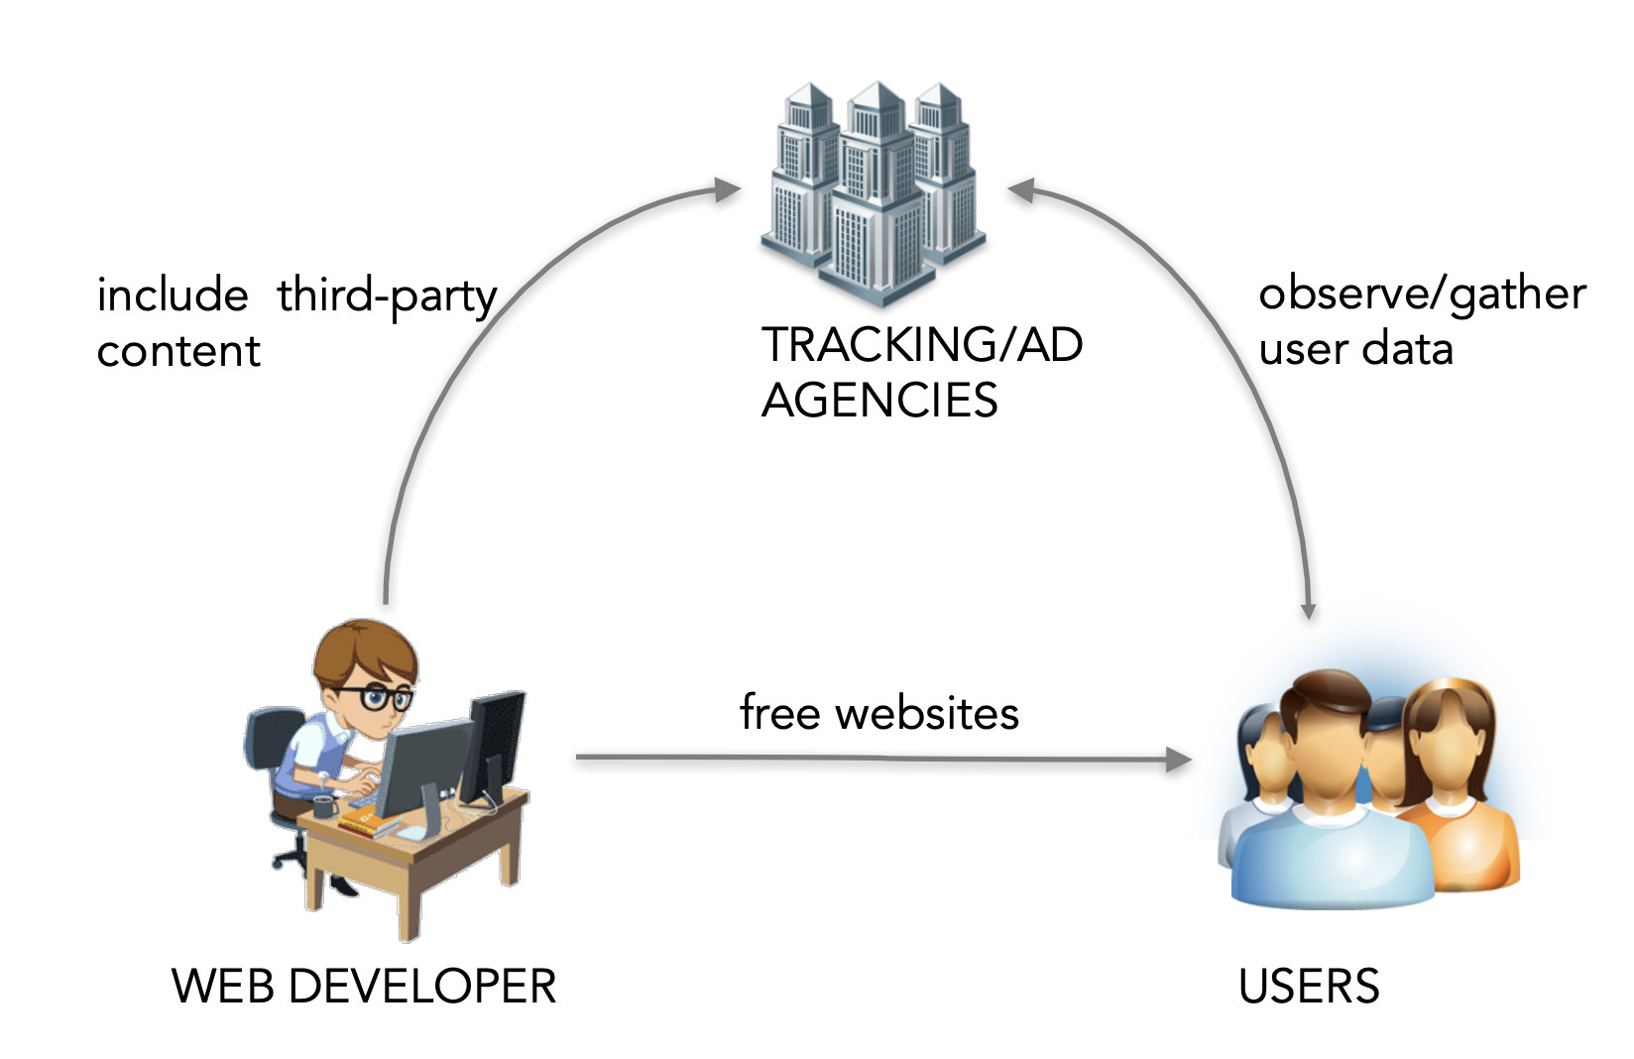
Business model of the Web

Slide 4
Research Challenges
Detection and measurement
Better
transparency
Raising awareness and configuration

Slide 5
Protection offered by browsers

Slide 6
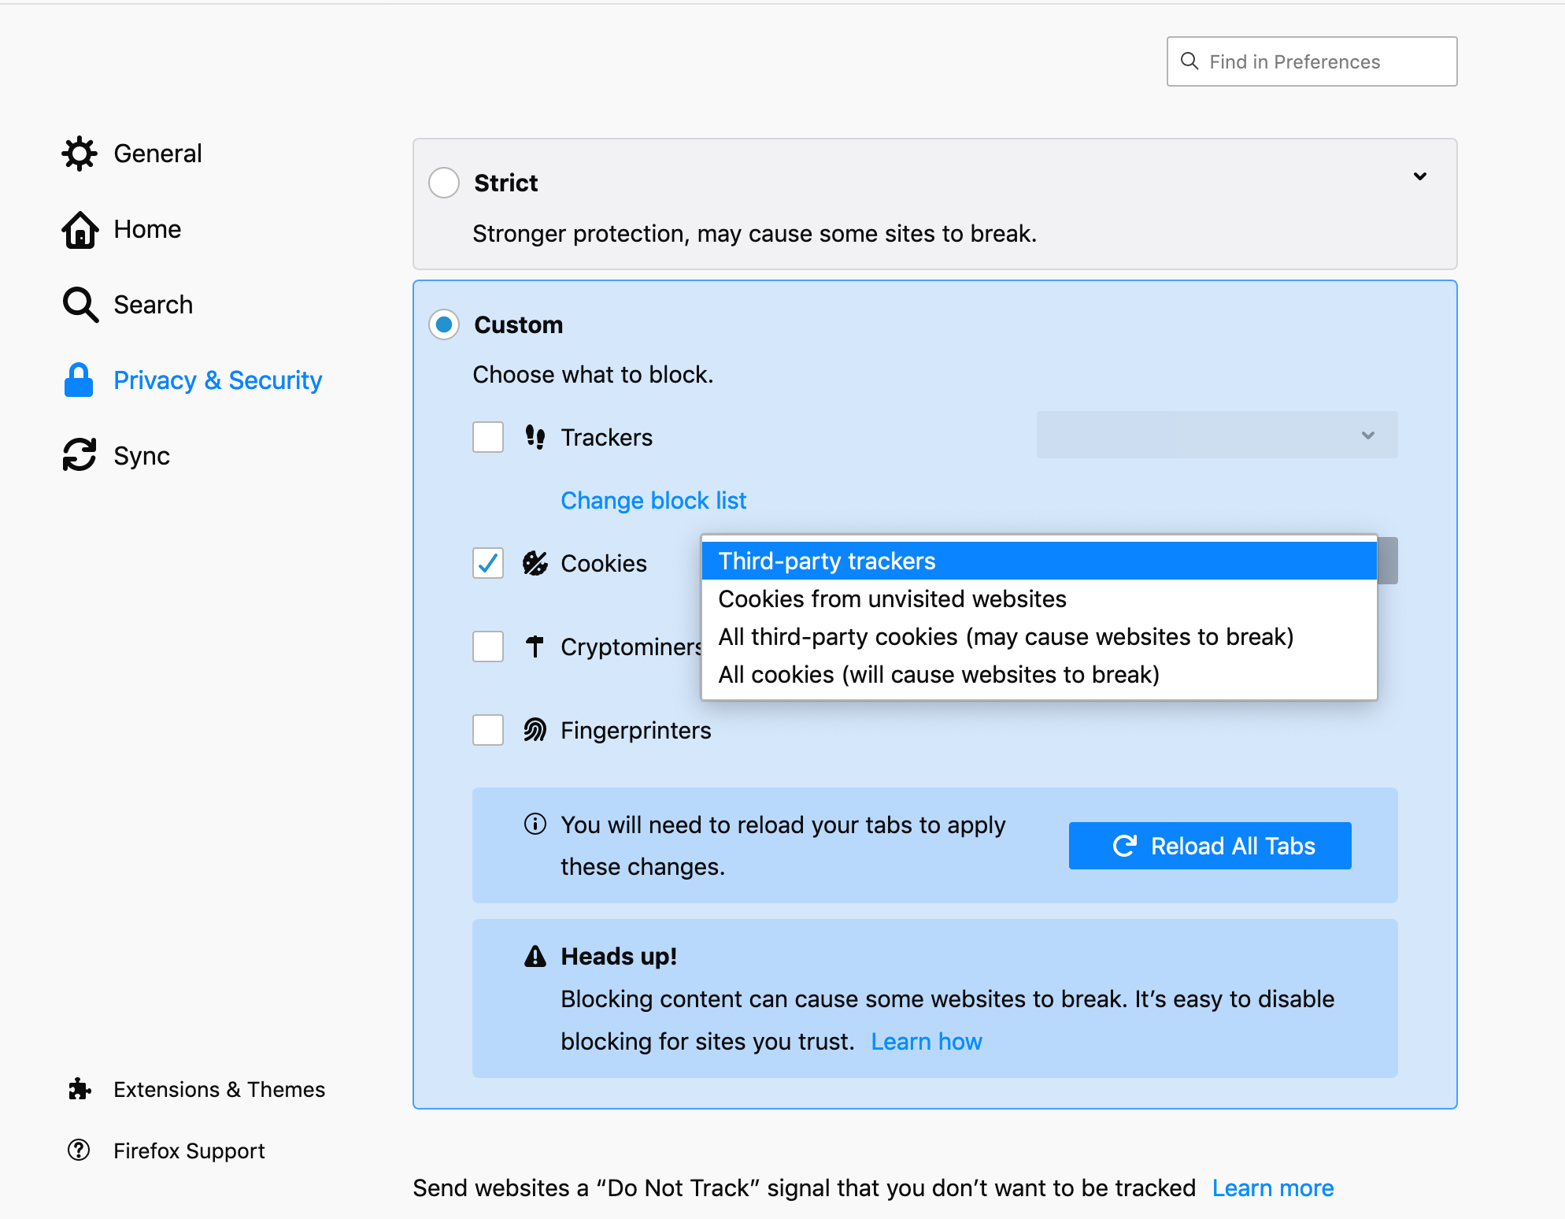
Blocking cookies in browsers
Firefox now, by default, blocks Third-party tracking cookies

Slide 7
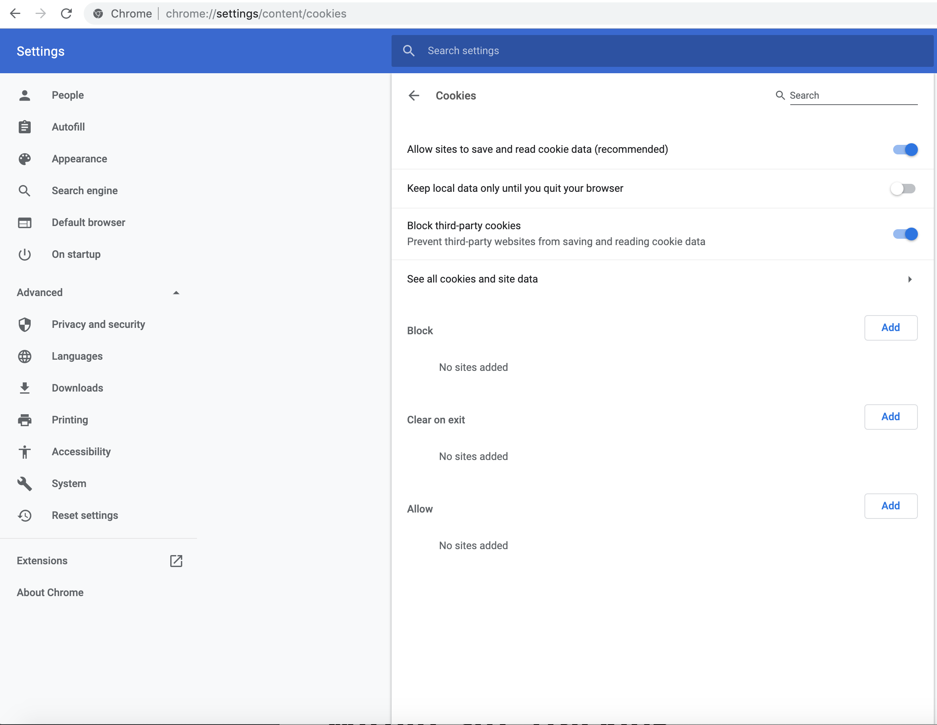
Sometimes settings are hard to find
Chrome users: Do you know how to find your cookie settings?
Difficult to find:
Settings → Advanced → Privacy and security → Site settings → Cookies

Slide 8
Do browser settings protect from within-site tracking?
Browser setting: block first-party cookies
blocks setting cookies upon HTTP responses
blocks setting cookies via JavaScript
blocks reading cookies via JavaScript

Slide 9
Protection from stateful tracking
Browser setting: block third-party cookies
Protects from tracking (purely) via cookies
Does not protect from cookie respawning
Does not protect from tracking via HTTP headers
Etag

Slide 10
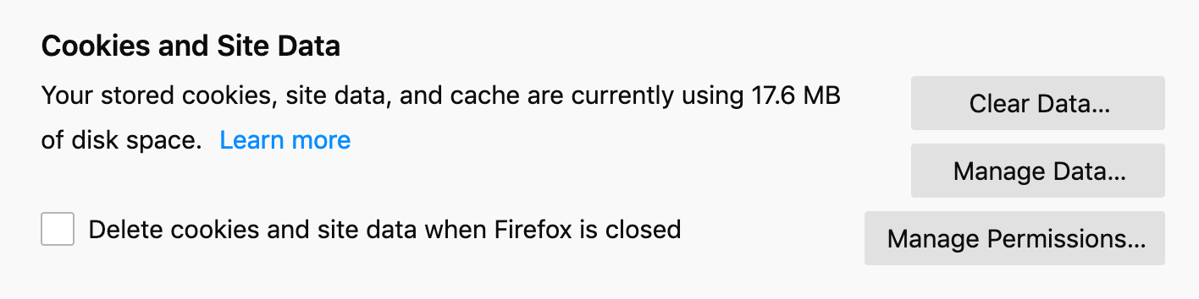
Delete cookies upon exiting
Pros: protects from basic cookie tracking
Cons: cookies can be restored via other storages; tracking possible through browser fingerprinting; users may not close browser

Slide 11
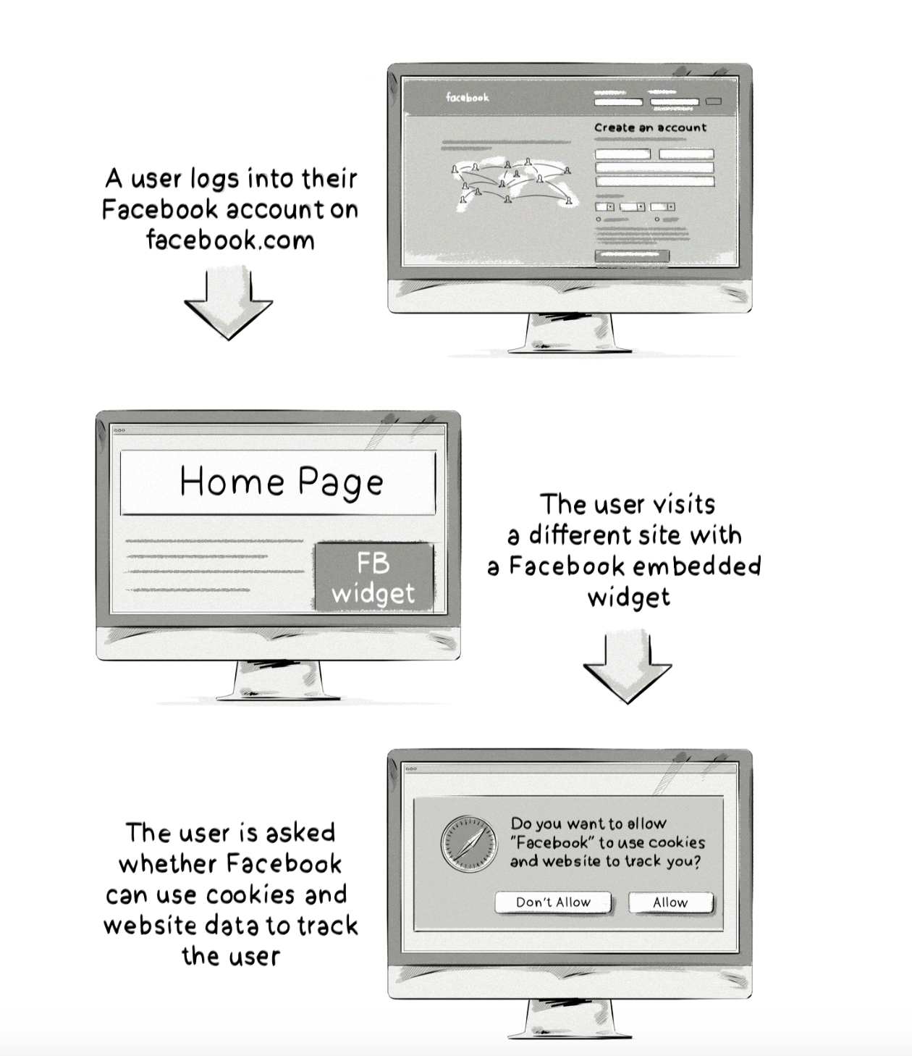
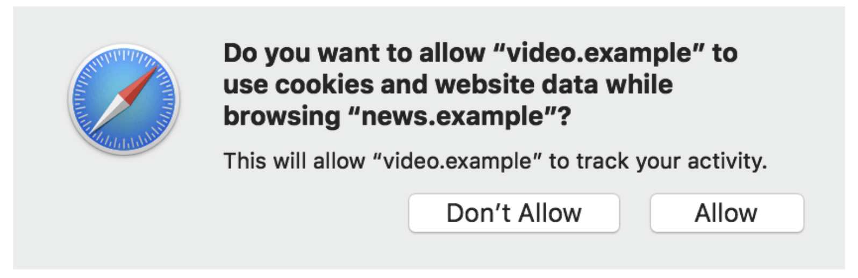
Safari’s Intelligent Tracking Protection
affects whether a company can access first-party cookies in a third-party context
all domains identified as having tracking capabilities will need to use the Storage Access API to access any type of cookie.

Slide 12
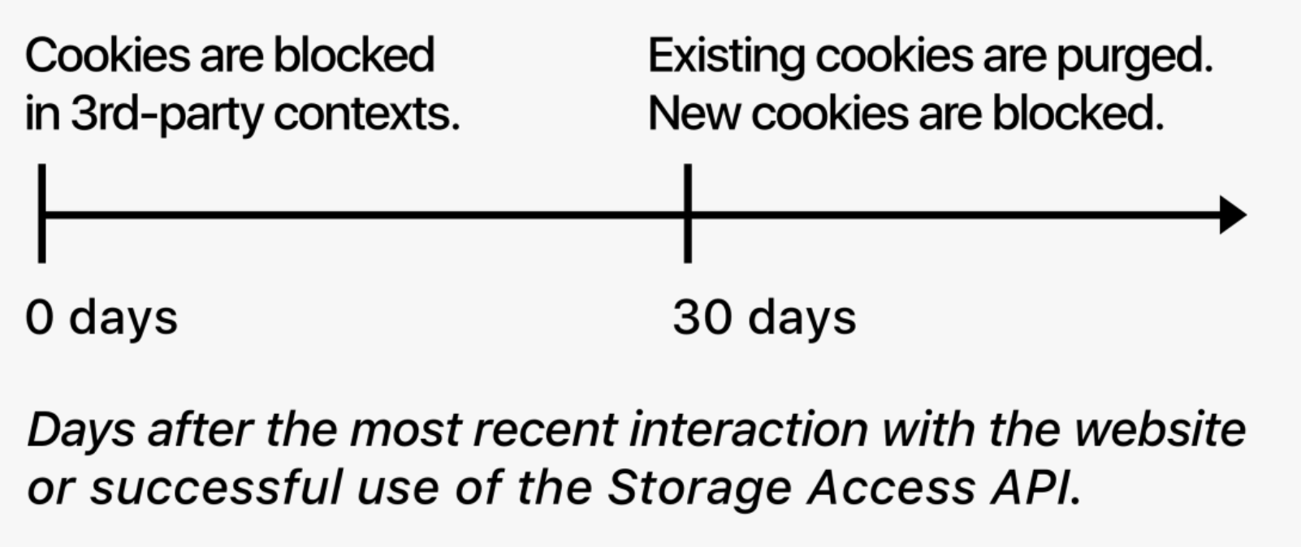
Safari’s ITP: limit cookie’s lifespan
Cookies can be set in two ways:
via server HTTP responses (server-side)
via JavaScript’s Document.cookie API (client-side)
Cookies created via the JS Document.cookie API (even first-party cookies) will be set to expire in seven days, regardless of their existing expiry date.
If a user doesn’t visit a site in 30 days the cookie for that site gets purged

Slide 13




Defense Against Social Widget Tracking
Often, 3rd party cookie blocking only impacts “trackers” that users don’t directly visit
E.g. Advertisers
A cookie is often embedded when you visit a site with a social widget
If user is signed into a social site the tracking is not anonymous
The cookie is available to the social site when the user visits a site on which the social site is embedded

Slide 14

ShareMeNot: blocking social widget
A browser extension that protects against tracking from third-party social media buttons while still allowing them to be used.
Firefox version: removes cookies from relevant requests until user clicks button.
Chrome version: replace buttons with local stand-in button until user click.
http://sharemenot.cs.washington.edu

Slide 15



ShareMeNot
http://facebook.com
facebook.com
processing engine
First-party site
Cookie Database
facebook.com: fb_id=522
logs
cookie: fb_id=522
2:34pm: user 522 visited facebook.com
http://site.com
2:35pm: user 522 visited site.com
<iframe src=faceboook.com/button.html>
</iframe>
Now is a part of Privacy Badger https://www.eff.org/privacybadger

Slide 16

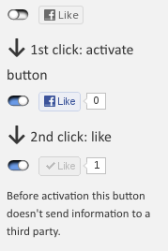
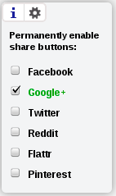
Safely include social buttons
Requests are still made so may learn IP address and other fingerprinting information
http://panzi.github.io/SocialSharePrivacy/

Slide 17
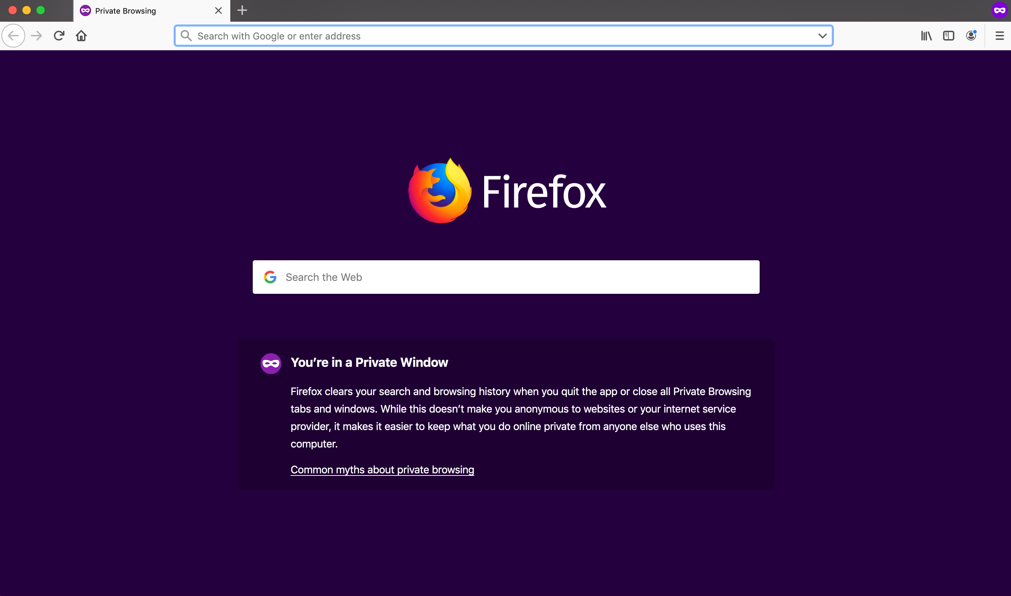
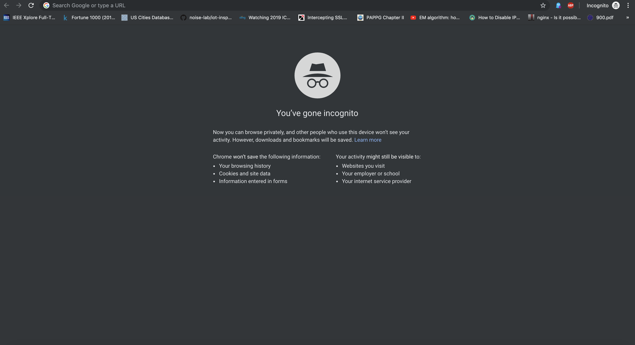
What about Private browsing mode?

Slide 18
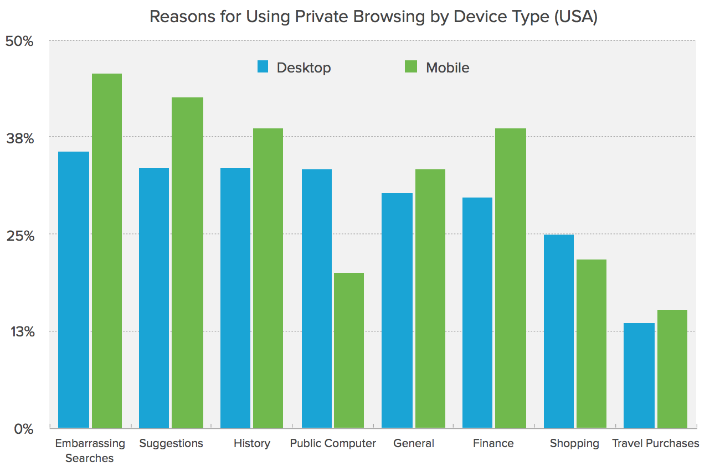
Do people use private browsing mode?
Duckduckgo study: 46% of Americans have used Private Browsing (5,710 random Americans)
Why use private mode?
https://duckduckgo.com/download/Private_Browsing.pdf

Slide 19
What does private browsing mode provide?
Which of the following is TRUE about private browsing mode? (choose all the applies)
Prevents Websites from Tracking Me
Prevents Ads from Tracking Me
Prevents Search Engines from Knowing My Searches Protects My Identity from Websites
Prevents IP from Being Seen
None of the above

Slide 20
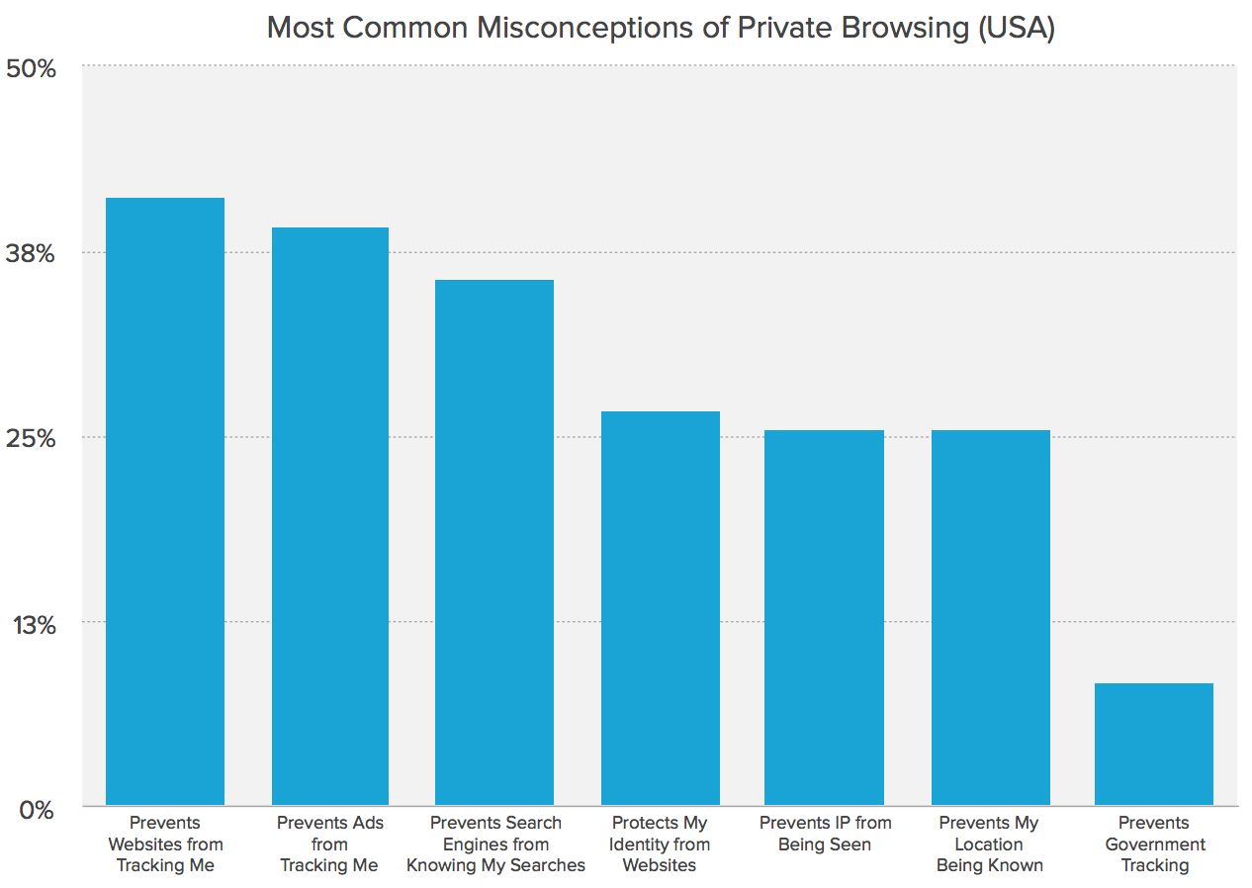
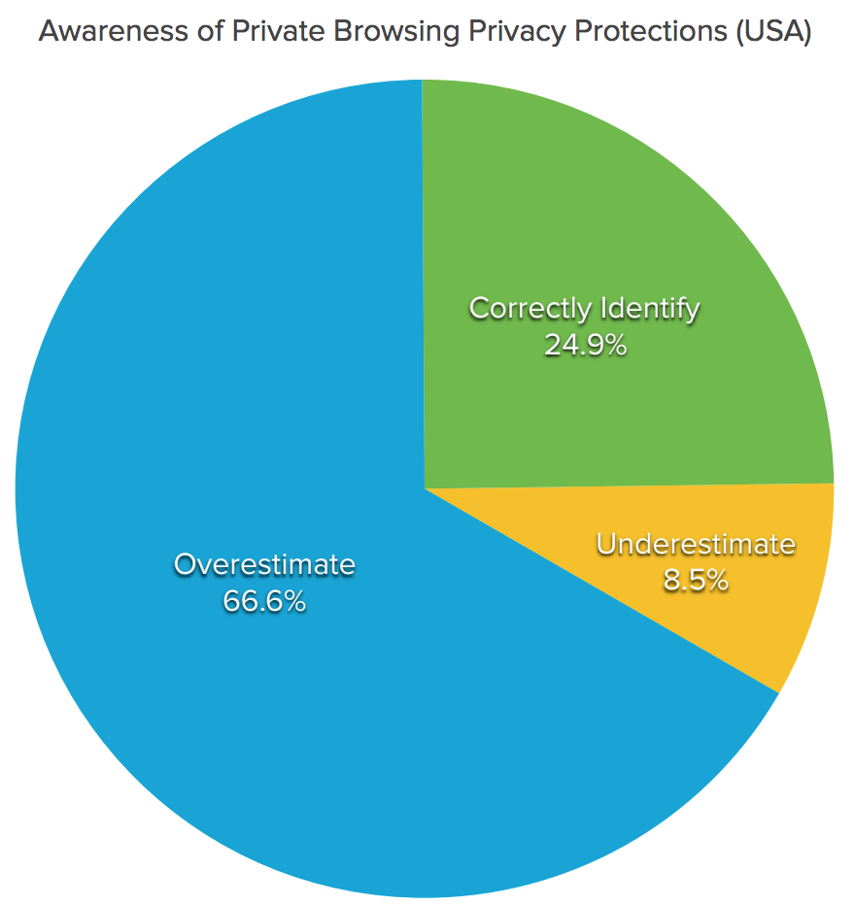
Misconceptions for private browsing mode
IP address trackable
if logged in then trackable
browser/device fingerprintable
https://duckduckgo.com/download/Private_Browsing.pdf

Slide 21

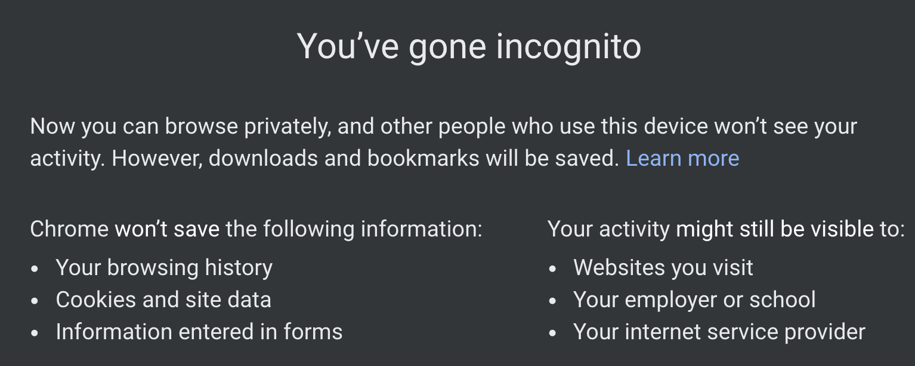

Summary: private browsing mode
What does it provide?
Deletes browsing data once browsing session ends
doesn’t store history, cookies, cache, passwords
Keeps browsing history private from other users sharing the same computer
Sites cannot link a user’s private session with their public session
Sites cannot link user’s two separate private sessions

Slide 22
Do Not Track (DNT) proposal
Idea initiated in 2009
Built as Firefox extension with DNT passed as a header option
W3C tasked to standardize the protocol in 2011
0 – user consents to allow online behavioral tracking
1 – user does not want to be tracked
Null – The user has not set the value for tracking. The user has no preference
on whether he or she should be tracked
All major browsers have options for enabling DNT
There is no standard for how companies and websites interpret and use DNT

Slide 23
DNT Adoption Issues
“But the NAI [Network Advertising Initiative] code also recognizes that companies sometimes need to continue to collect data for operational reasons that are separate from ad targeting based on a user’s online behavior. For example, online advertising companies may need to gather data to prove to advertisers that an ad has been delivered and should be paid for; to limit the number of times a user sees the same ad; or to prevent fraud.”
Translation: we’re going to keep tracking you, but we’ll simply call it “operational reasons.”

Slide 24
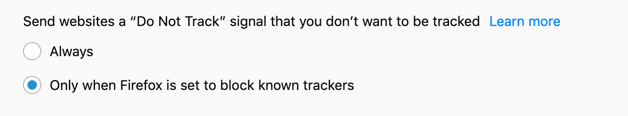
Issues with DNT
No legislation in United States to enforce
Most advertisers do not honor DNT setting
Good intent but does little
2012: DNT enabled by default in IE 10
2015: Microsoft made DNT opt in (not enabled by default)

Slide 25
Extension based protections

Slide 26



Extensions for privacy protection
Extensions “ad-blocking”
Block visible advertisements
Extensions “tracking-blocking”
Block invisible tracking
Example: request for an invisible image with third-party cookies

Slide 27

Ad block extensions
Use the same consumer lists that detect ad companies
Block requests to domains presented in the lists

Slide 28
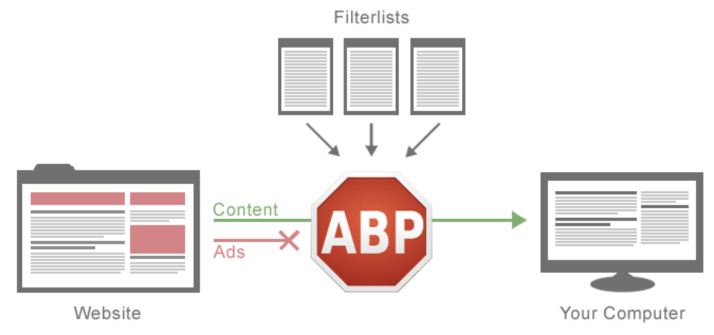
How does AdBlock Plus work?
Fixed set of filterlists
Community maintained
https://easylist.to/

Slide 29
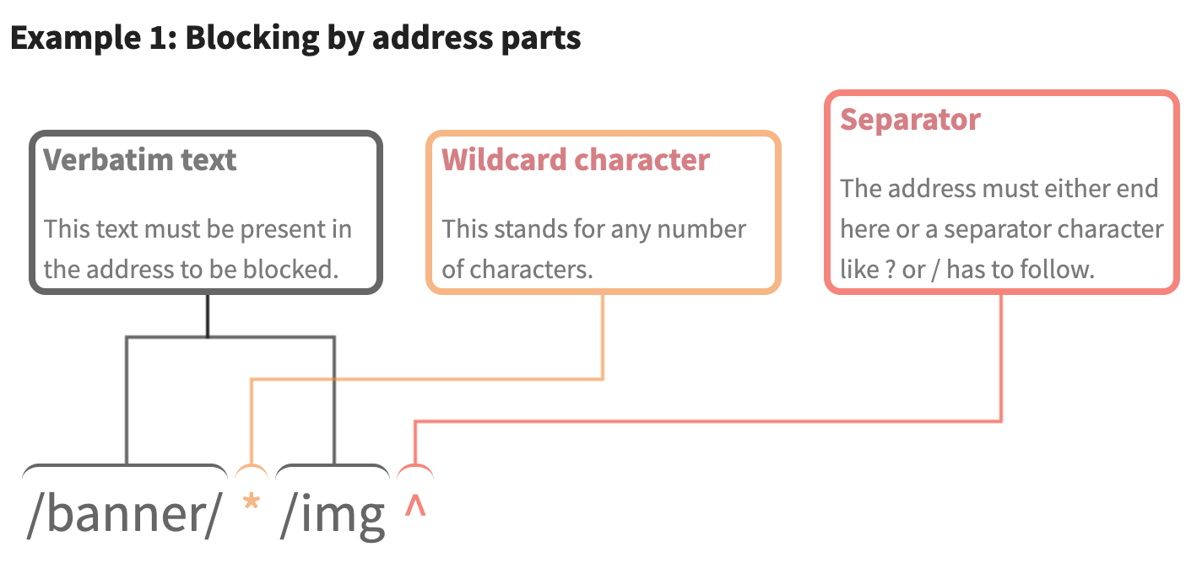
Examples of filtering rules
Exercise:
Blocked? URL
Yes
Yes
No
http://example.com/banner/foo/img
http://example.com/banner/foo/bar/img?param
http://example.com/banner/foo/img.gif
https://help.eyeo.com/en/adblockplus/how-to-write-filters

Slide 30
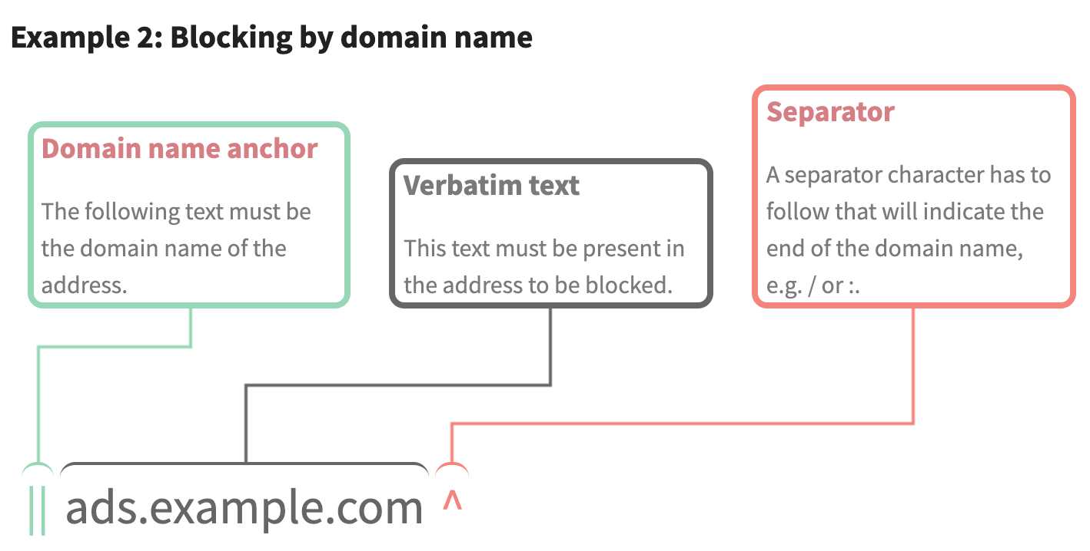
Examples of filtering rules
Exercise:
Blocked? URL
Yes
No
http://server1.ads.example.com/foo.gif
http://ads.example.com.ua/foo.gif

Slide 31
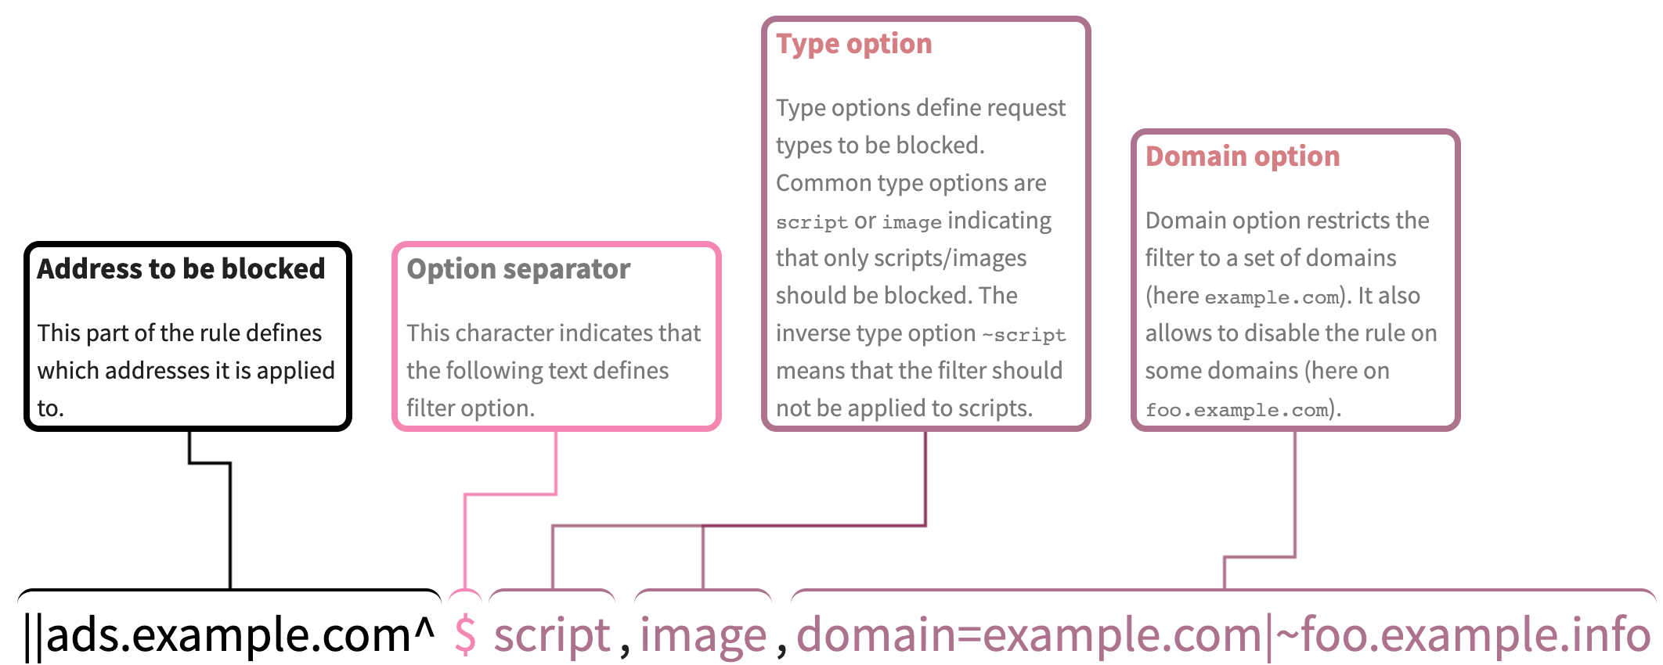
Filtering rules with options
This rule blocks http://ads.example.com/foo.gif only if the following conditions are met:
This address is being loaded as a script or an image
The page loading it comes from example.com domain (for example example.com itself or subdomain.example.com) but not from foo.example.info or its subdomains

Slide 32
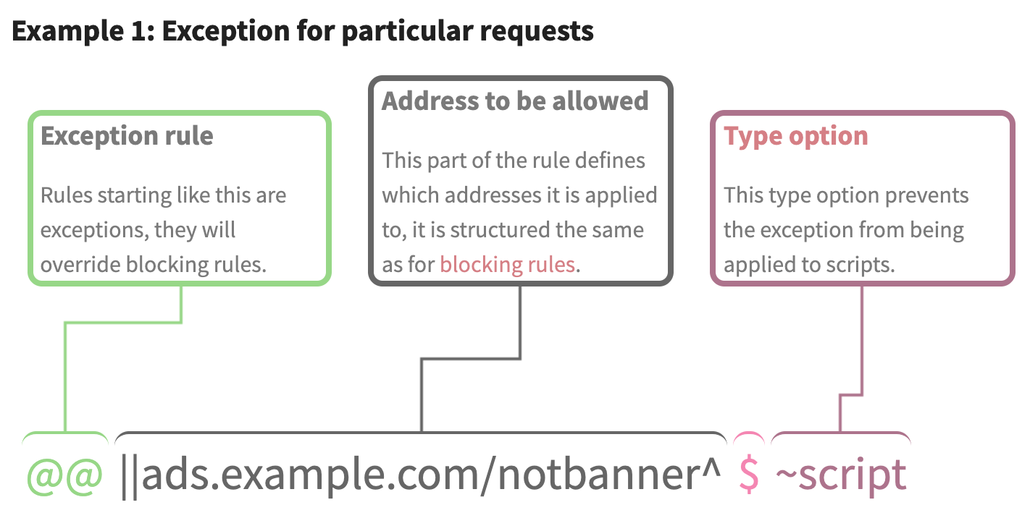
Exception rules
Let’s see a live demo
No
Yes
Will a script from https://ads.example.com/notbanner/ be blocked?
Yes

Slide 33

Adblock Plus

Slide 34
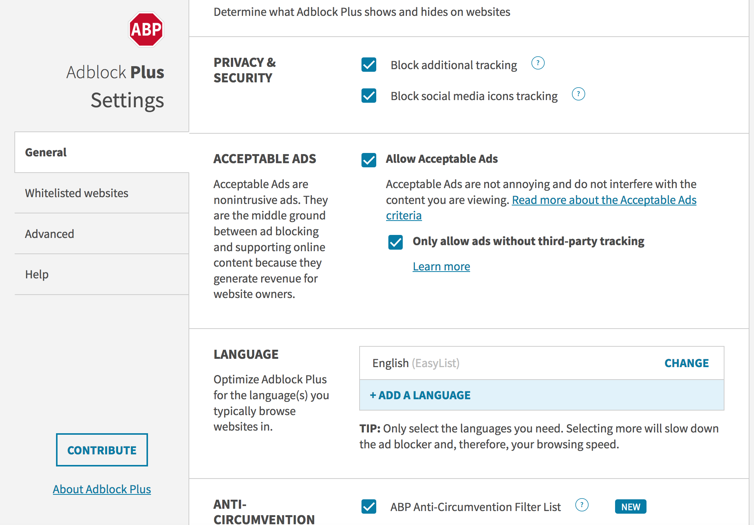
Adblock Plus

Slide 35
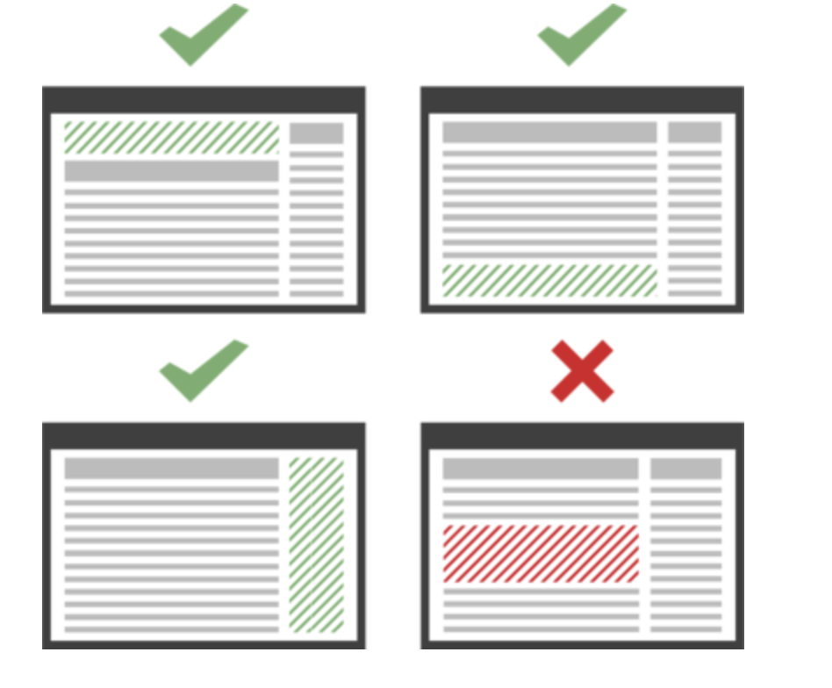
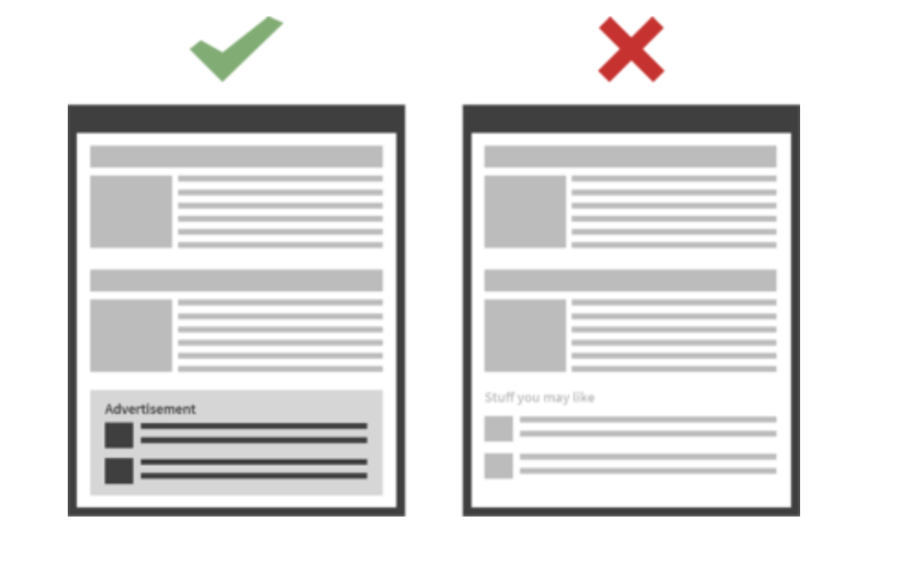
Which ads are « acceptable »?
An action initiated by Eyeo (Ad Block owner)
Which ad is acceptable ?
Well-placed, well-identified, not too big size…
Large entities have to pay to show the ads even if their ads are already acceptable!

Slide 36
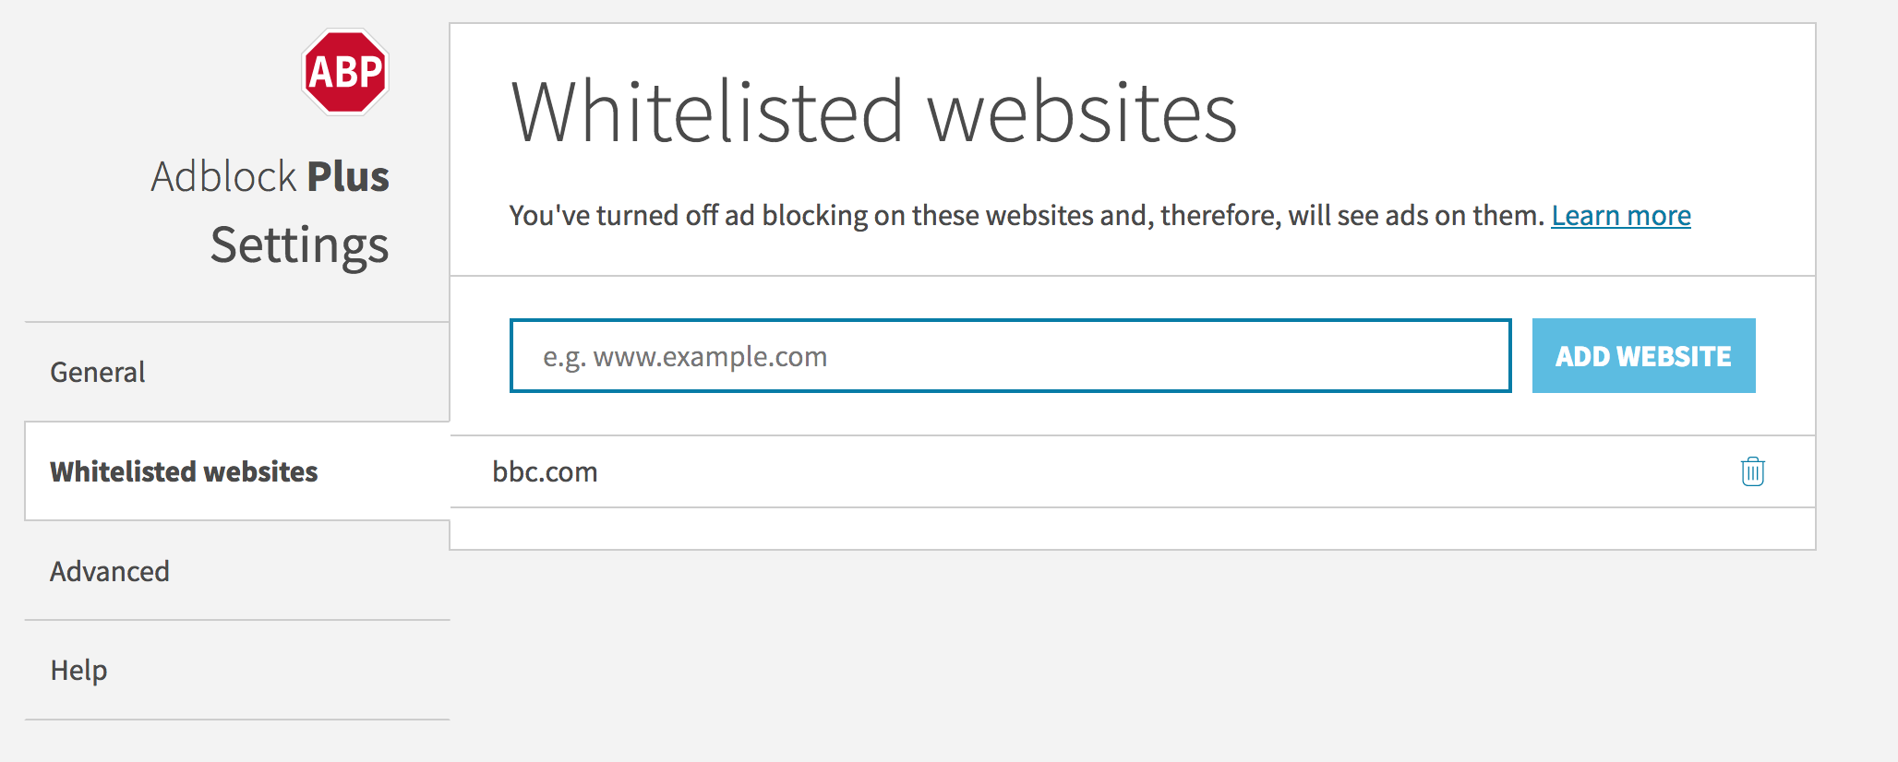
Adblock Plus
You can whitelist domains

Slide 37
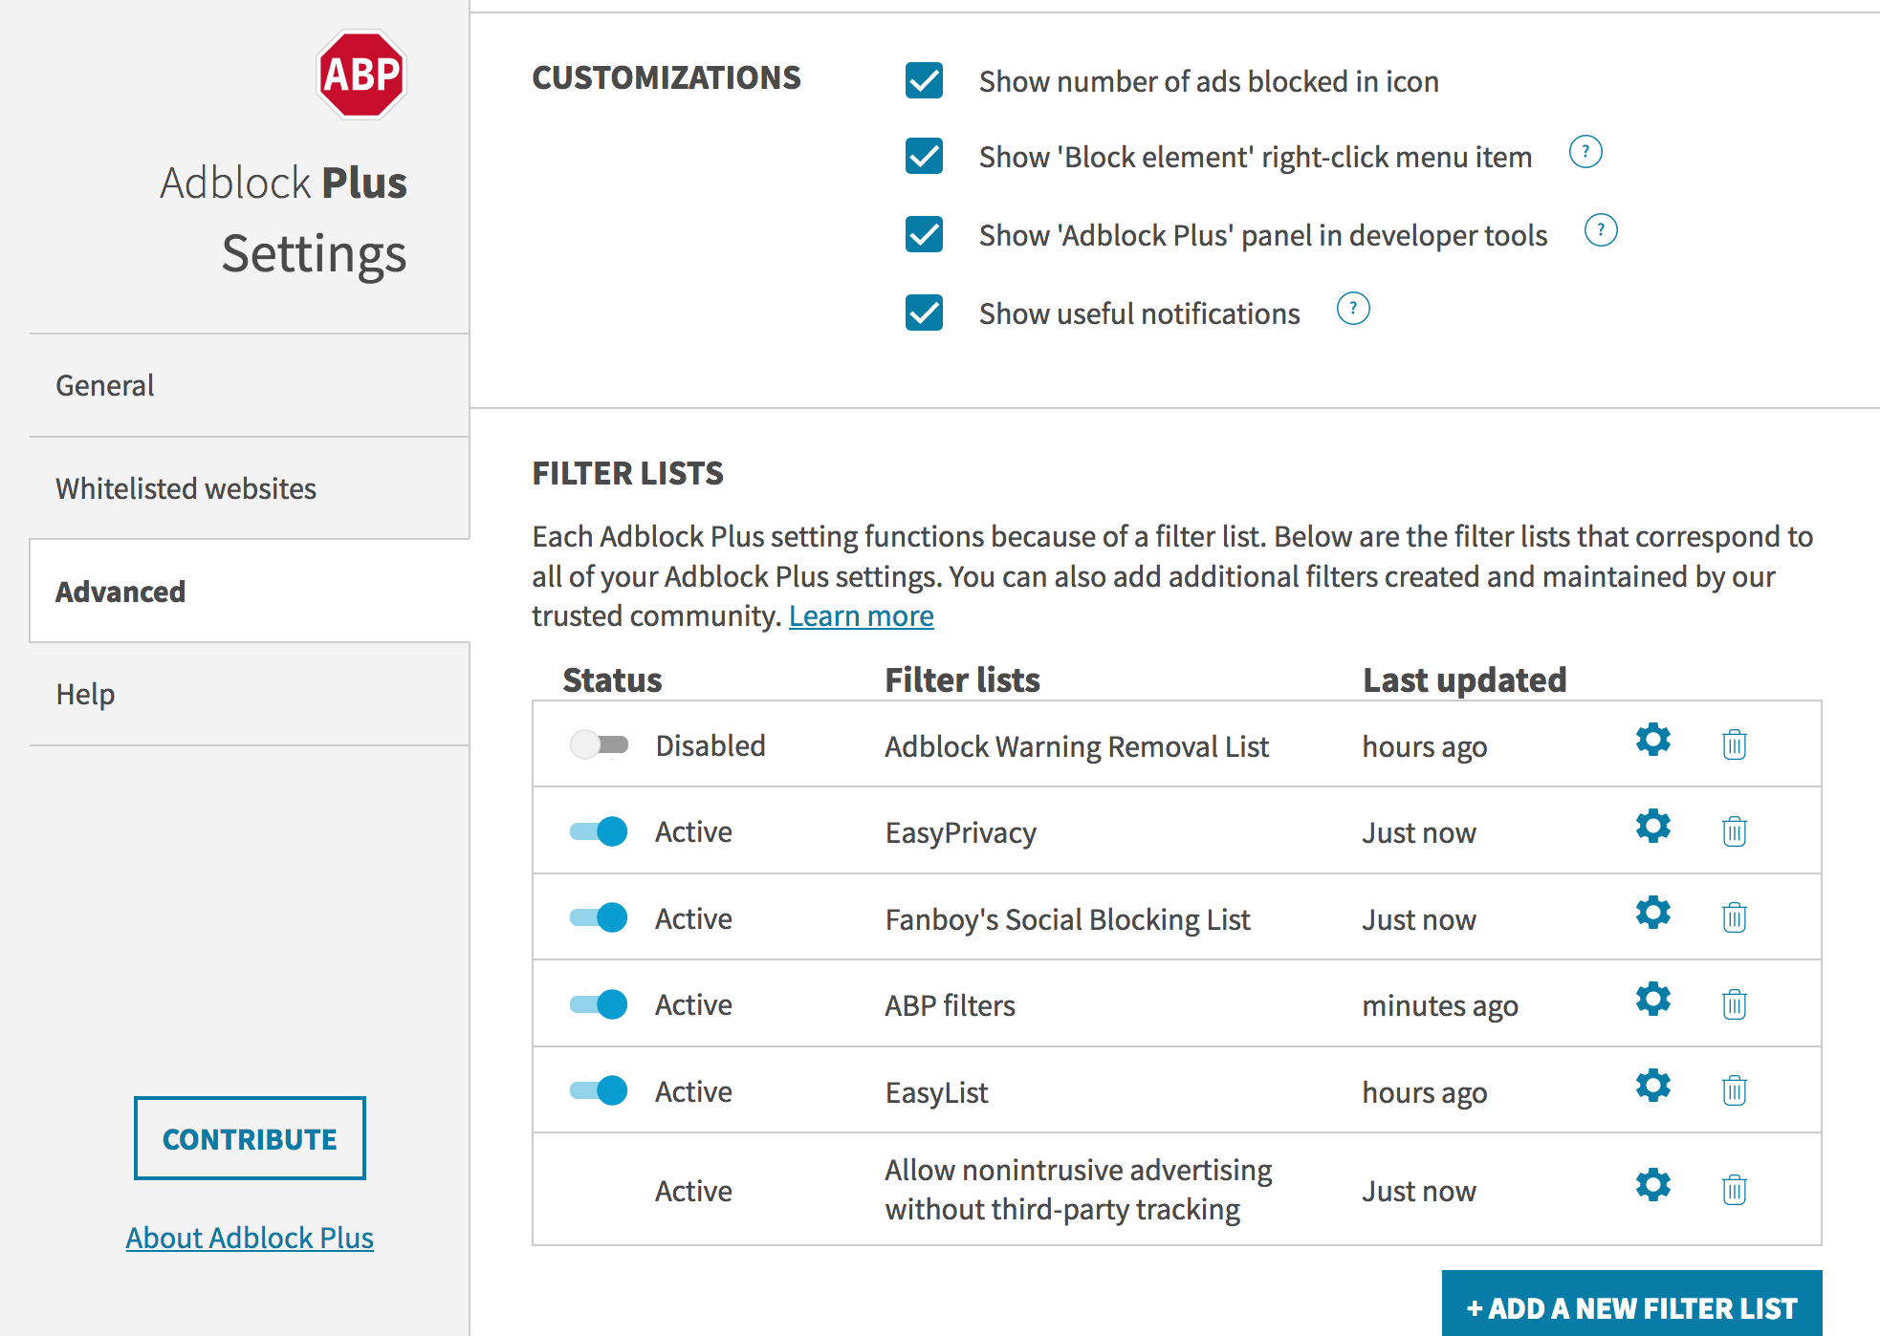
Adblock Plus
Add you own block list
Easylist most common https://easylist.to/index.html
Blocking rules explained at https://adblockplus.org/filter-cheatsheet

Slide 38
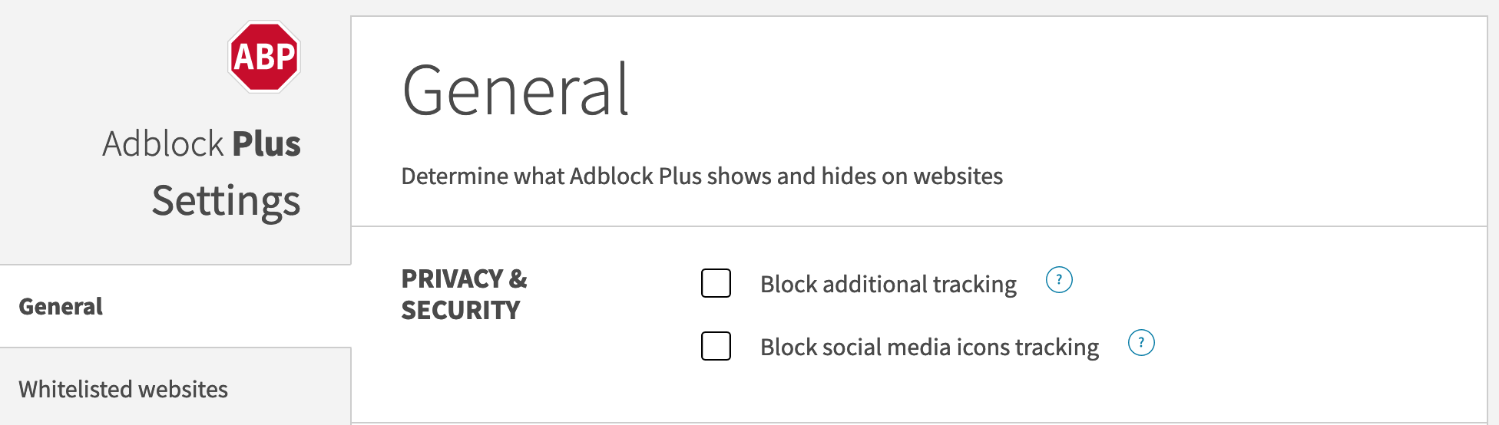
Configuration of AdBlock Plus
Tracking blocking is not enabled by default

Slide 39

Ad-blocking ≠ tracking-blocking!
Extensions block ads but do not block all the tracking
tracker.com
http://site1.com
http://site2.com
cookie: id=789
<iframe src=tracker.com/ad.html>
</iframe>
processing engine
Cookie Database
9:30am: user 789 visited site1.com
ad
cookie: id=789
tracker.com: id=789
9:31am: user 789 visited site2.com
logs

Slide 40
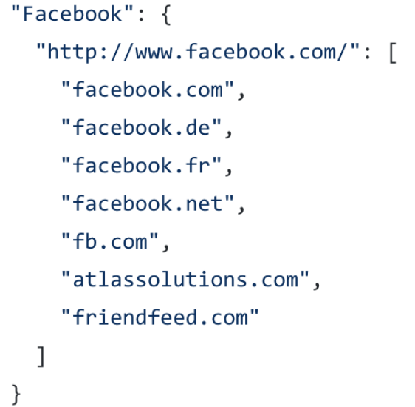
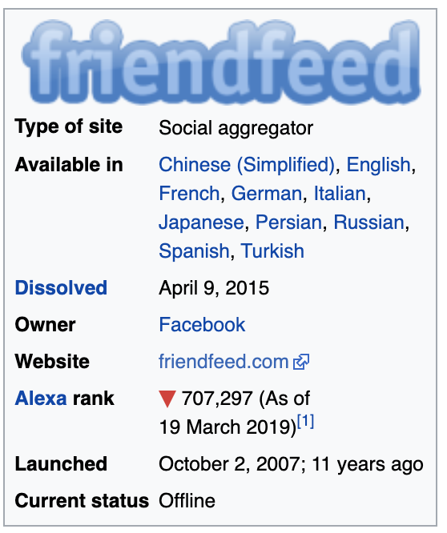
Tracking-blocking extensions
How to detect a tracker ?
Solution 1: use a list of known companies for tracking
Solution 2: use rules based on the behavior of potential trackers
Example : third-party content that sets third-party cookies with a unique identifier

Slide 41
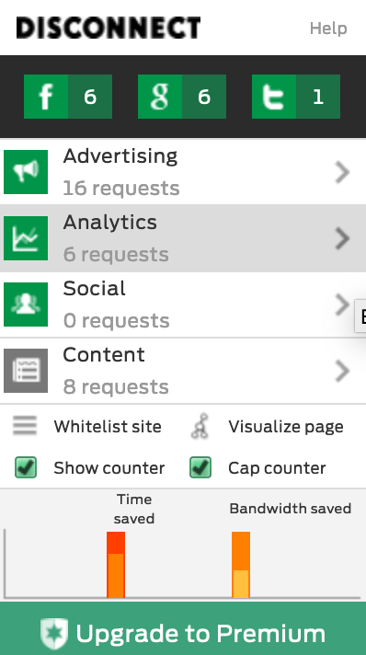

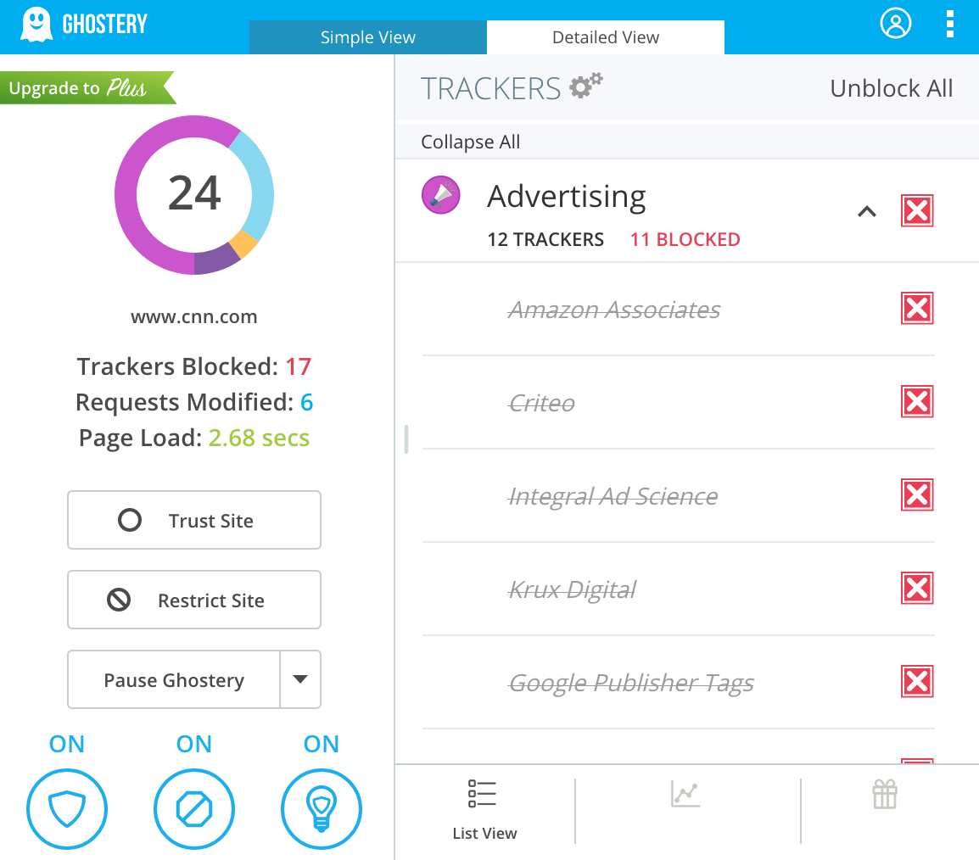
Tracking-blocking extensions
Extensions use their own lists of known companies for tracking
Blocks from tracking upon installation
Firefox uses this list for blocking trackers
Doesn’t block from all trackers by default!
User has to explicitly select which trackers to block

Slide 42
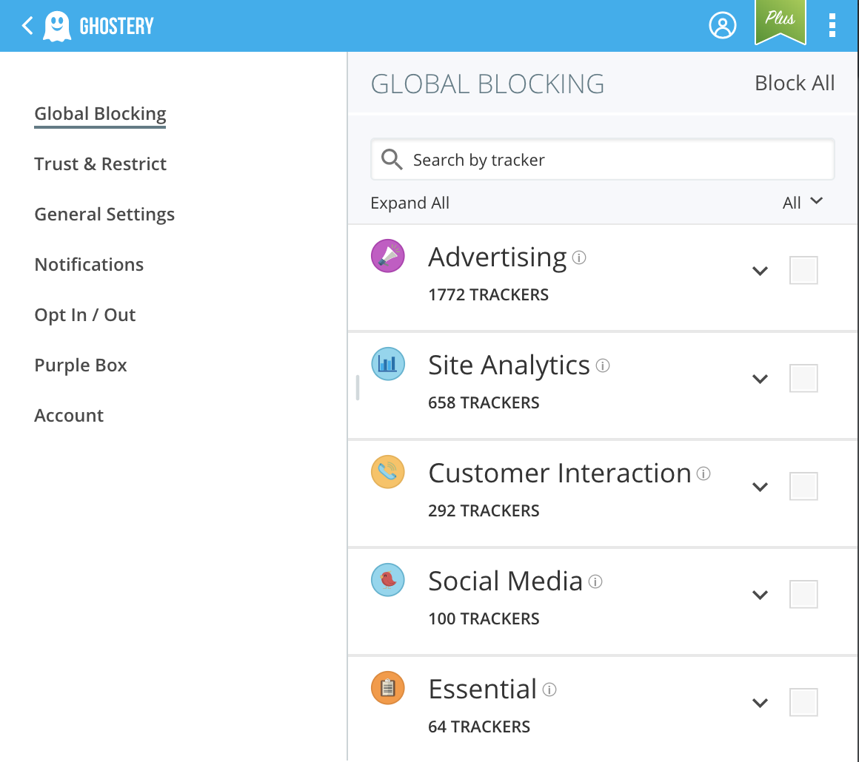
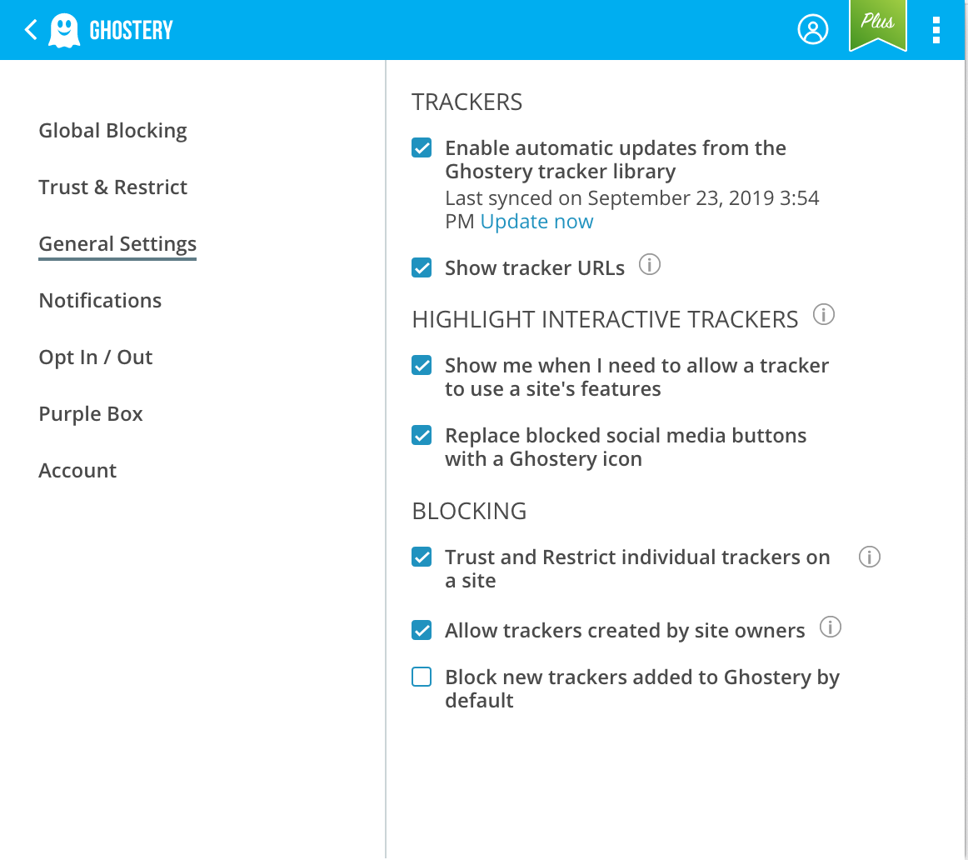
Ghostery: activate blocking of trackers
Need to click here to block all known trackers

Slide 43
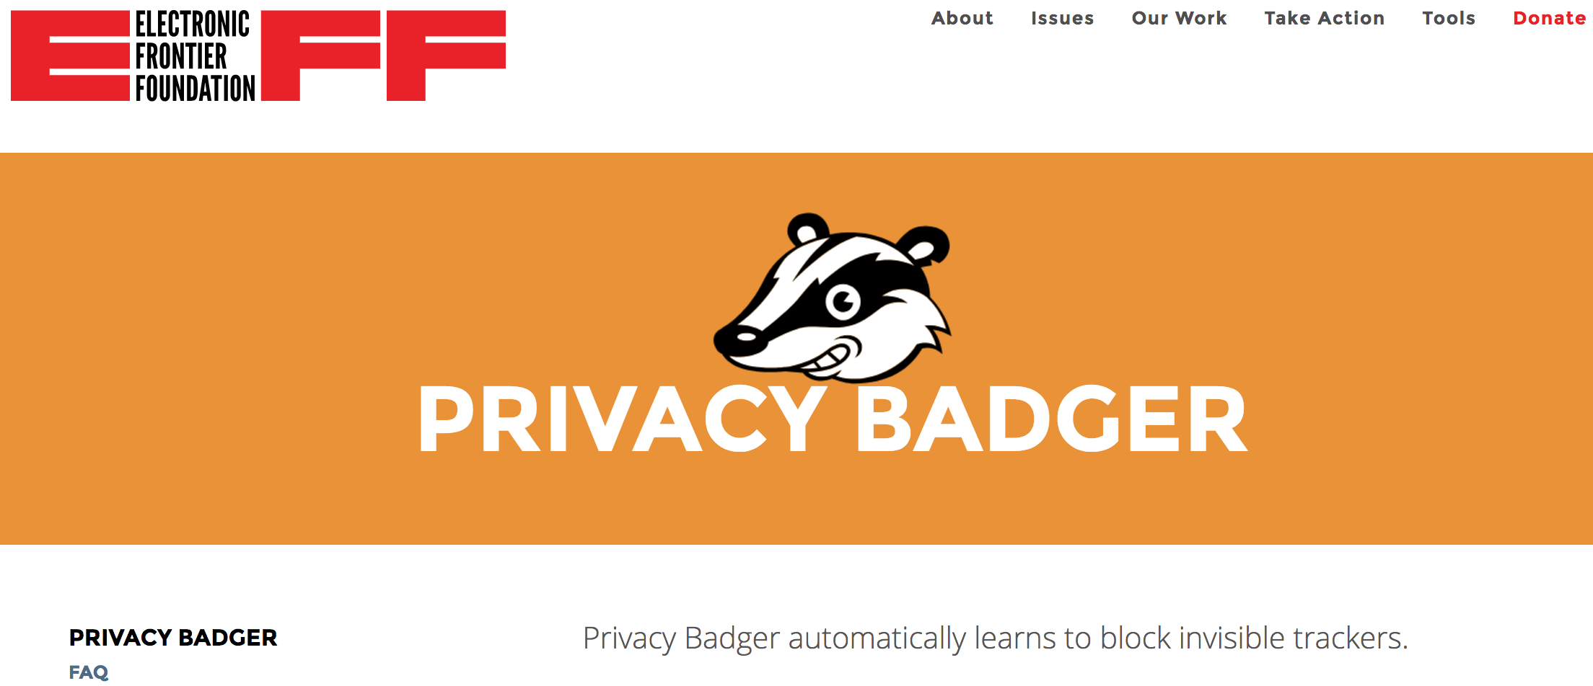
Algorithmic approach to detecting trackers
One extension uses rules based on the behavior of potential trackers
Uses algorithmic methods to decide what is and isn't tracking rather than depending on a blacklist
How to detect tracking domain?
Observing requests between first-party and third-party domains, and searching for the presence of the same high-entropy strings (e.g., identifiers) across multiple first-party sites → third-party domain is potentially a tracker

Slide 44
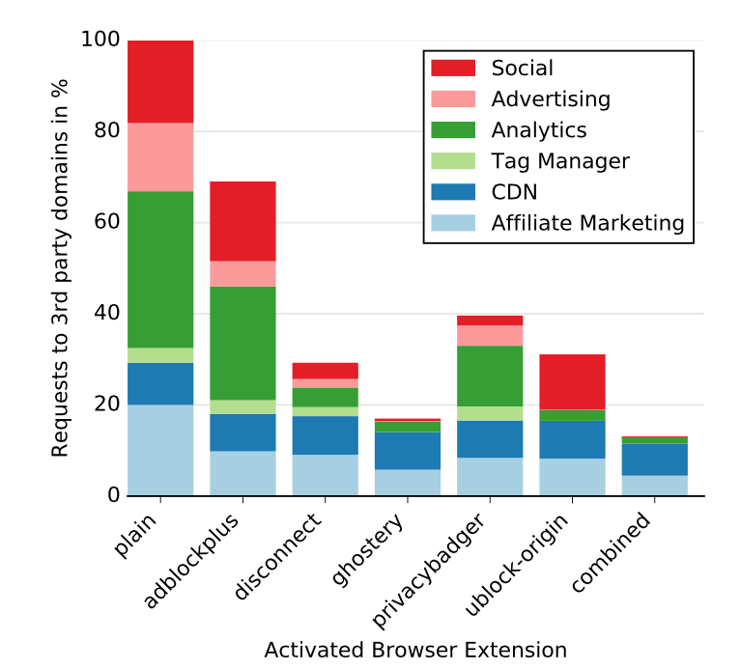
Browser extensions block all trackers?
Which extension is most effective?
In terms of 30 most popular third-party services found on 123,876 sites
Users may falsely believe that they are fully protected from tracking!
Merzdovnik et al. Block Me If You Can: A Large-Scale Study of Tracker-Blocking
Tools . IEEE EuroS&P 2017.

Slide 45
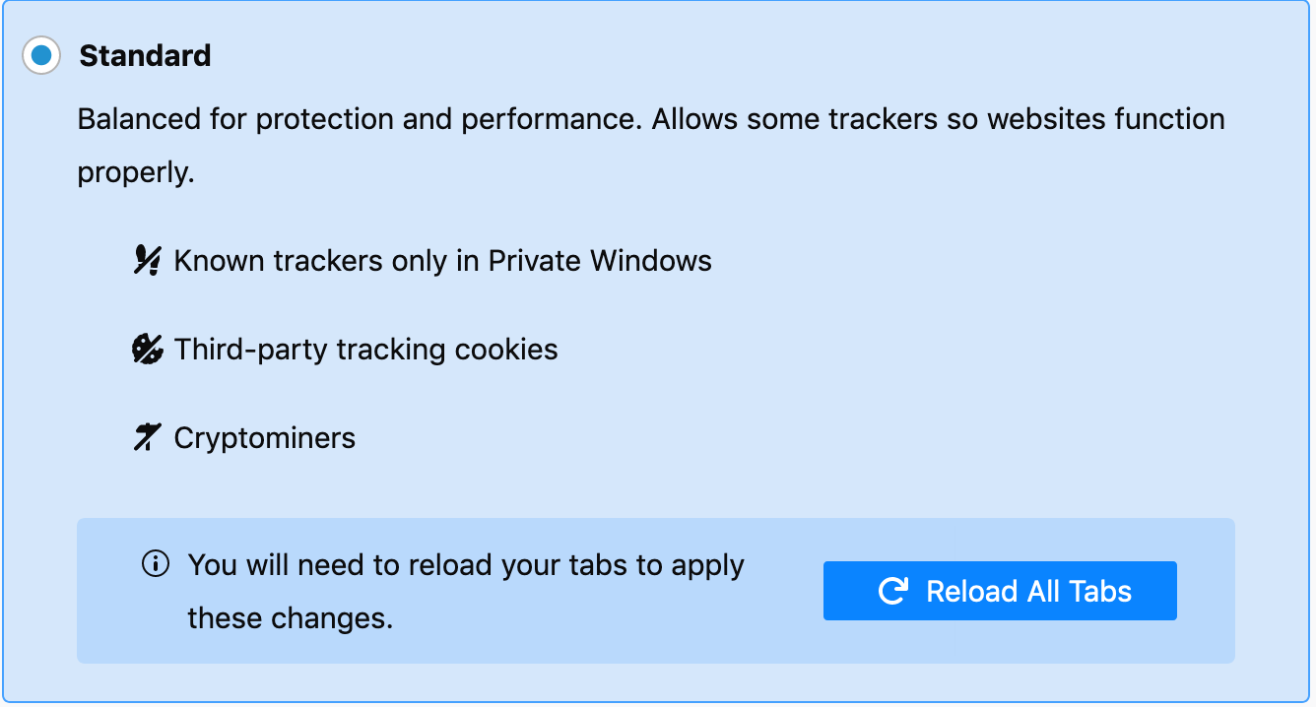
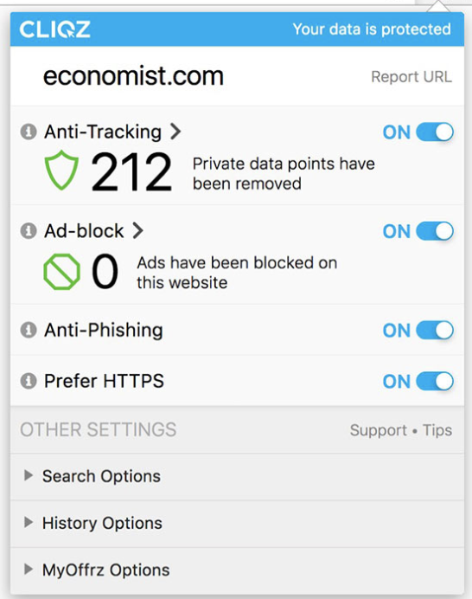
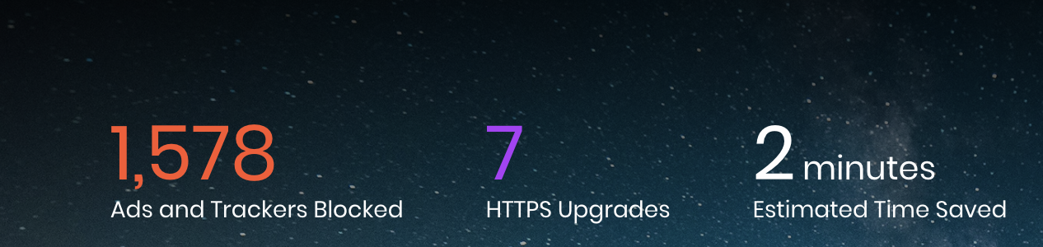
Browsers with integrated tracking protection
Brave
Cliqz
Firefox
Third-party cookies are blocked upon installation
Blocks cross-site trackers
Doesn’t block social media widgets
Third-party cookies are blocked upon installation
Tracking protection based on the behavior of third-party requests
Known trackers only in Private Windows
Third-party tracking cookies

Slide 46
Things to look out for
Ad-blocking ≠ tracking-blocking!
Extensions that block ads do not necessarily block tracking
Installation ≠ protection
Always double-check that all the protecting options are chosen!
Advices to protect from stateful tracking:
Browsers that protect by default (Brave, Cliqz)
Browsers with protection integrated (Firefox)
Combination of various extensions (Disconnect, Ghostery, Privacy Badger)

Slide 47
Defending against browser fingerprinting

Slide 48
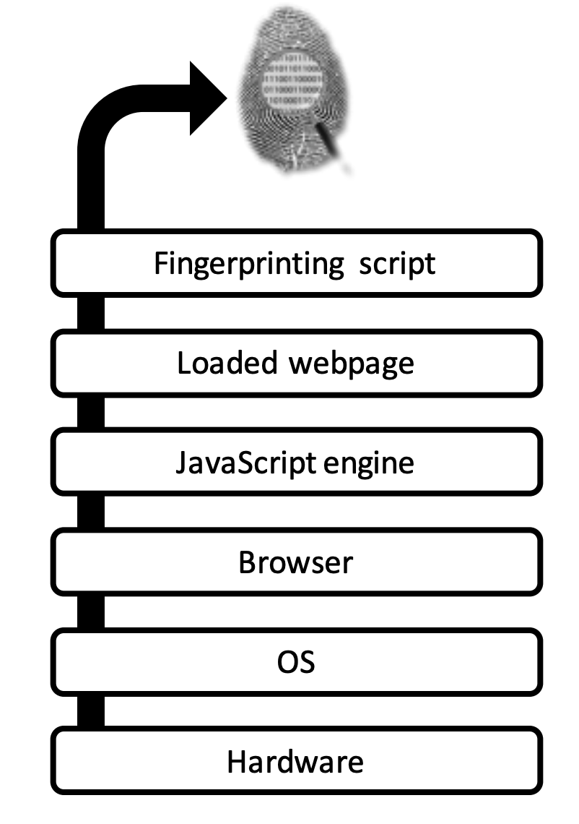
Defenses against browser fingerprinting
Browser fingerprint: Browser, operating system and hardware-level properties are used to uniquely track repeated visits to a site
Goal: to protect users against browser fingerprinting, i.e. to prevent them from being tracked online

Slide 49
Randomization or Normalization
Randomization: Randomize attributes (Canvas Defender)
Adds noise to the APIs
Functionality might suffer
Trackers may use other info to detect randomization
Normalization: Make everyone look same
JavaScript API normalization approaches, such as those used by the Tor Browser and the Brave browser, attempt to make all users return the same fingerprint.
Spoofing similar values
Functionality might suffer

Slide 50
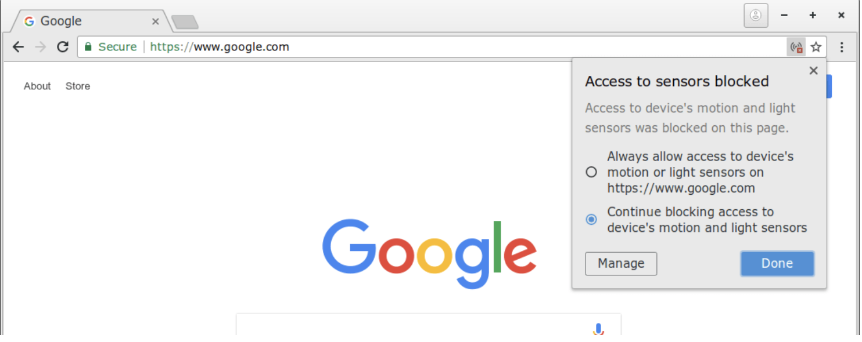
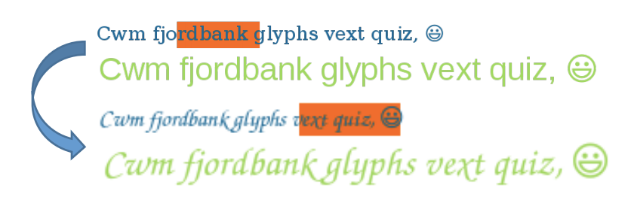

Way to thwart FP
noscript
Many different approaches:
Blocking scripts
Blocking browser APIs
Injecting JavaScript
Spoofing attributes
Put APIs behind permission
Add noise through JavaScript
Spoof user-agent string

Slide 51
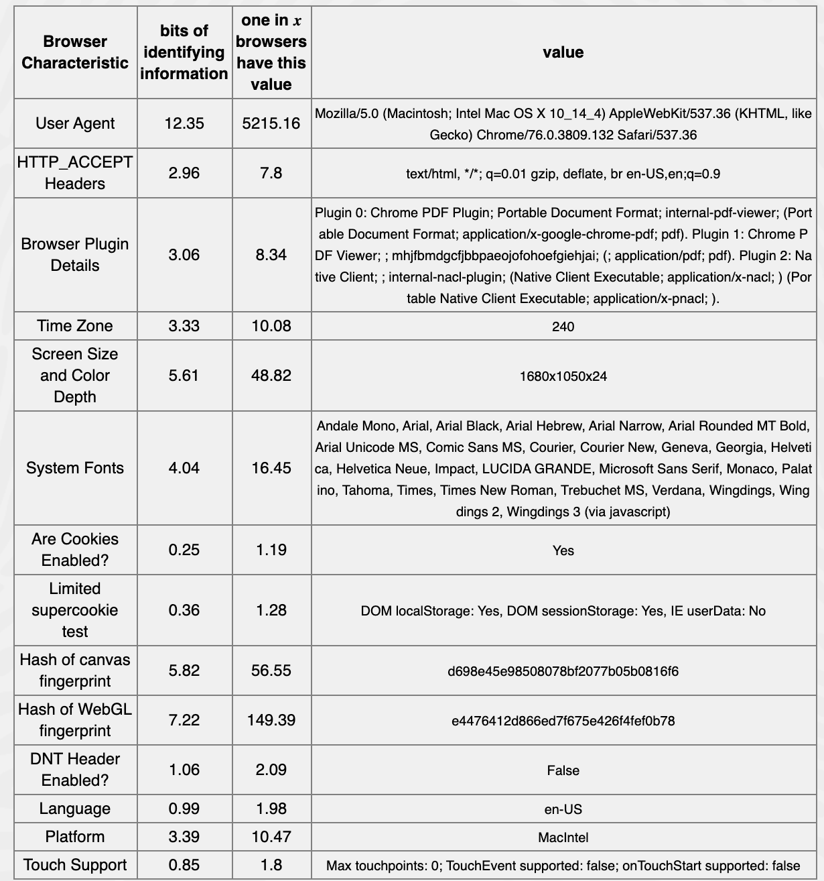
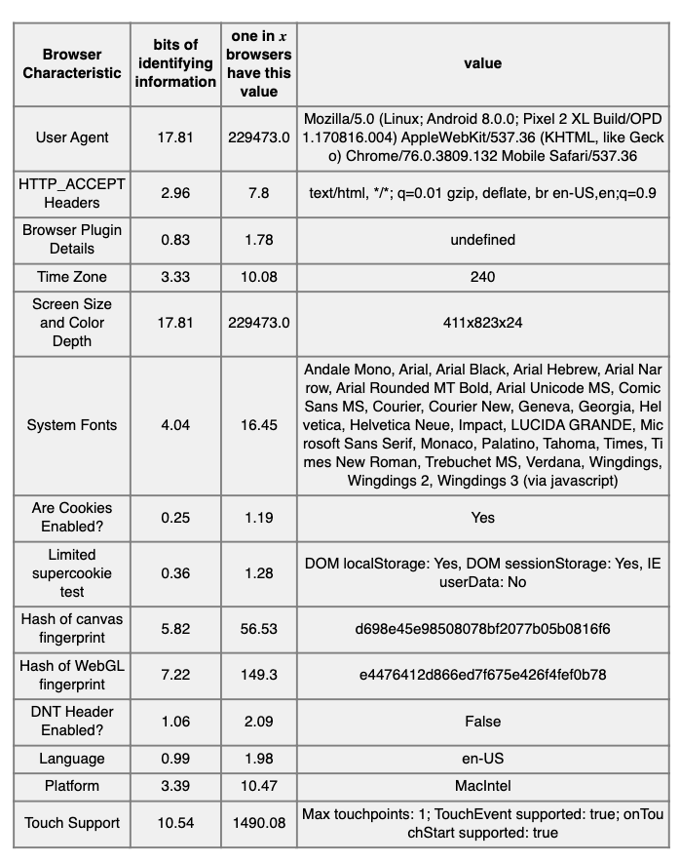
Spoofing might be easy to detect
Desktop
Spoofing as Mobile

Slide 52
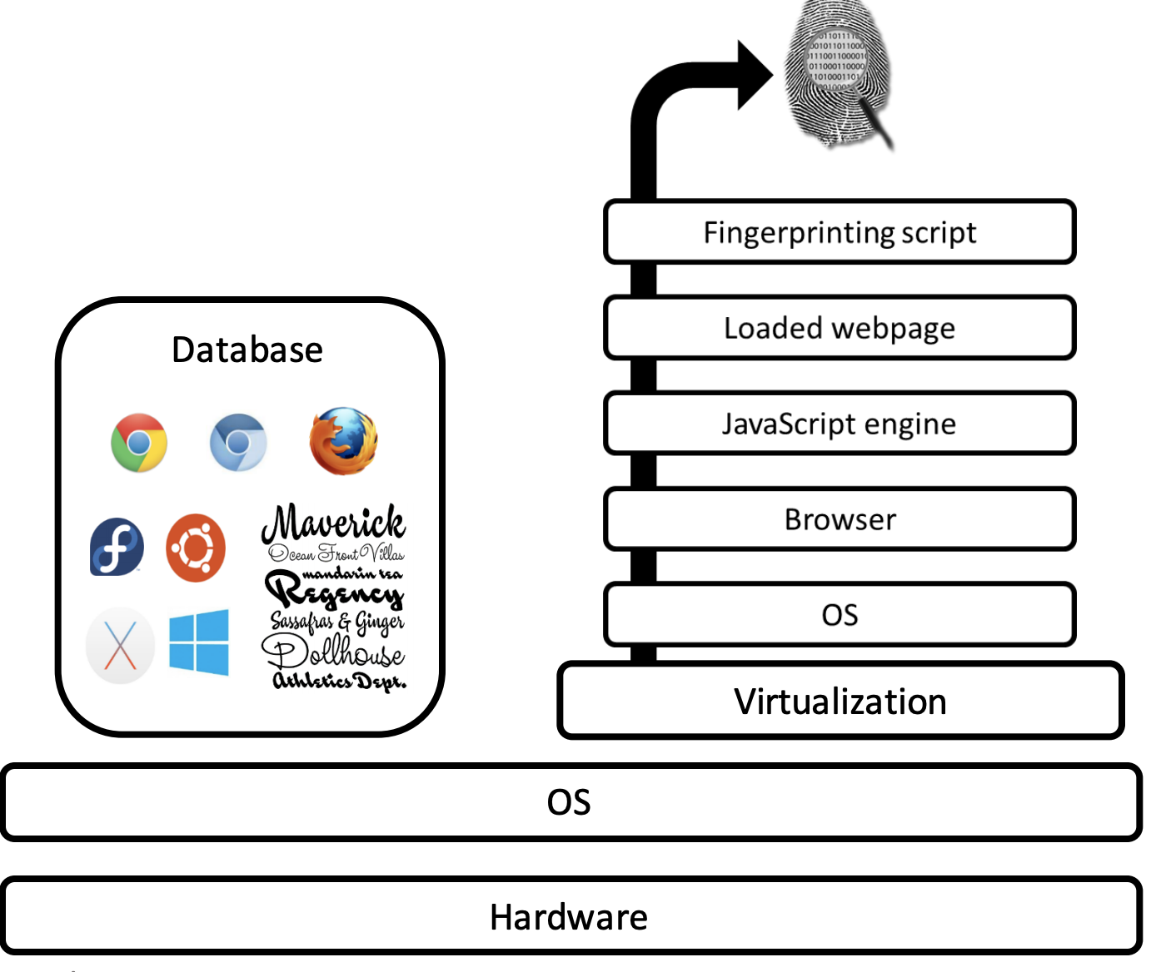

Other approaches
Recreating a complete environment
Switching between browsers
Disposable environments with a unique fingerprint for each browsing session
Database with different OS, fonts, plugins and browsers
Use of virtualization to isolate the host OS from the new environment
Pros: Anybody can switch between any browsers.
Cons: Cross-browser fingerprinting exists. By collecting enough information on the OS and hardware, one can still be identified.
using hardware information

Slide 53
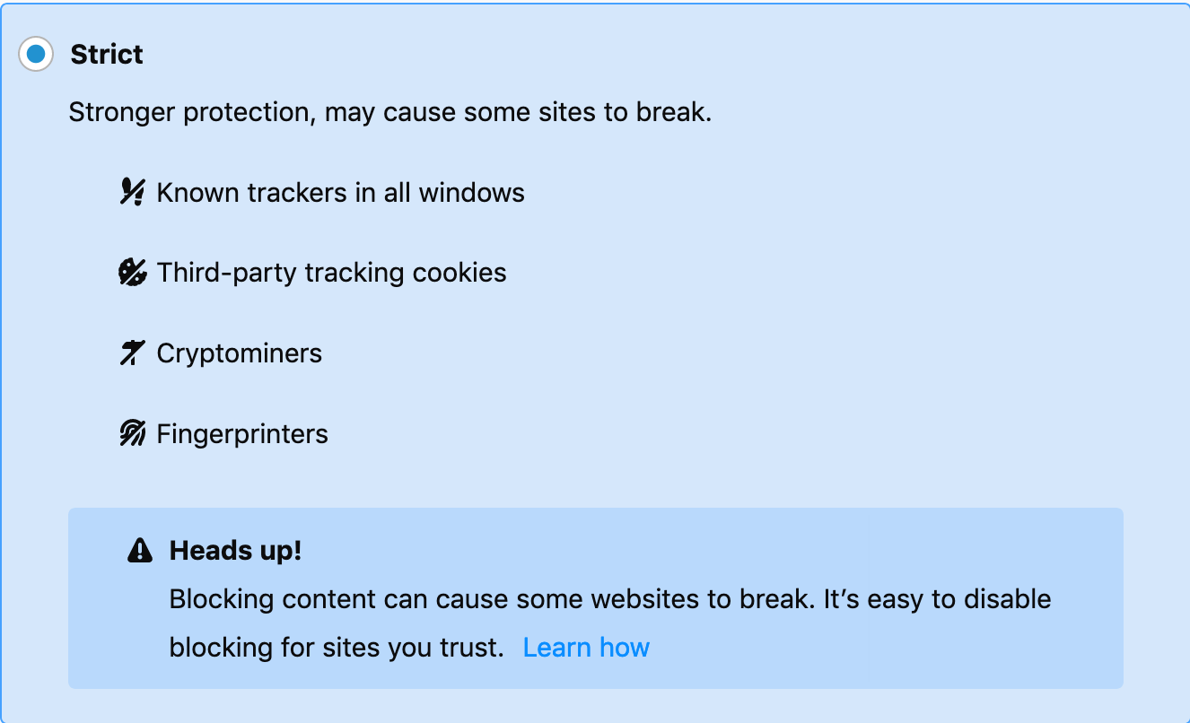
Takeaway
No ultimate solutions
Each one has its pros and cons.
It is always a complicated tradeoff between protection and usability.
Easiest solution to put in place: block fingerprinting scripts
Brave, Tor, Firefox browsers have tracking protection
has option to block fingerprinting scripts
Firefox settings

Slide 54
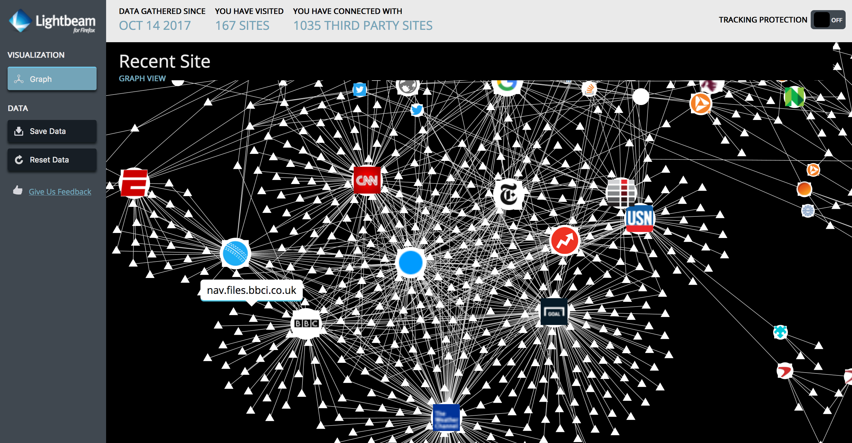
Firefox Lightbeam
view 3rd party requests are graph

Slide 55
Impact of regulation
Transparency to tracking

Slide 56
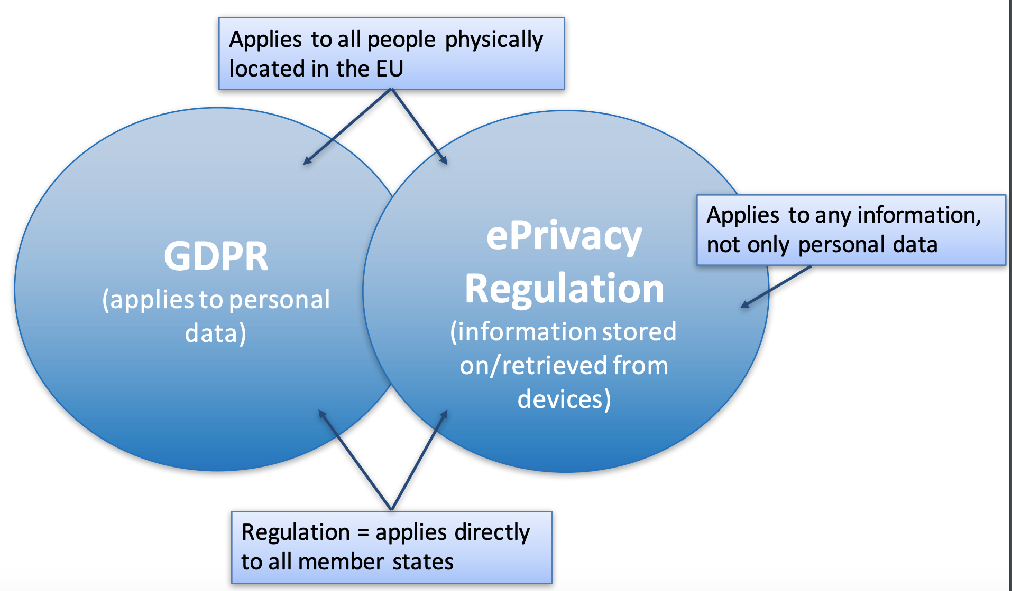
Existing regulations
In EU
GDPR
ePrivacy (cookie law)
In US
no specific regulation exists to control tracking
various agencies such as DAA (Digital Advertising Alliance) recommend ethical best practices
companies engaged in OBA (online behavioral advertising) will indicate their adherence to ethical best practices for OBA by providing an Advertising Icon (Adchoice)

Slide 57
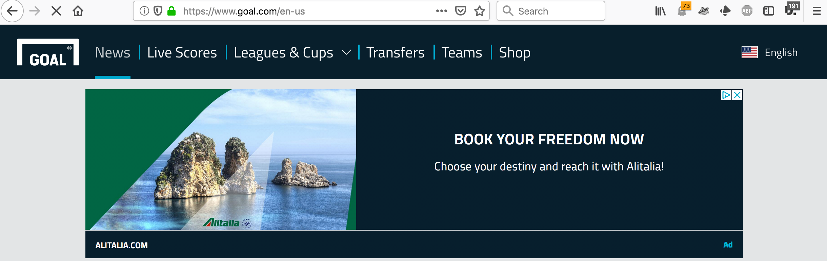
Ad transparency

Slide 58

DAA ad choice
Self-regulatory principles
Promotes better transparency
But hard for users to see and too much work to opt-out

Slide 59
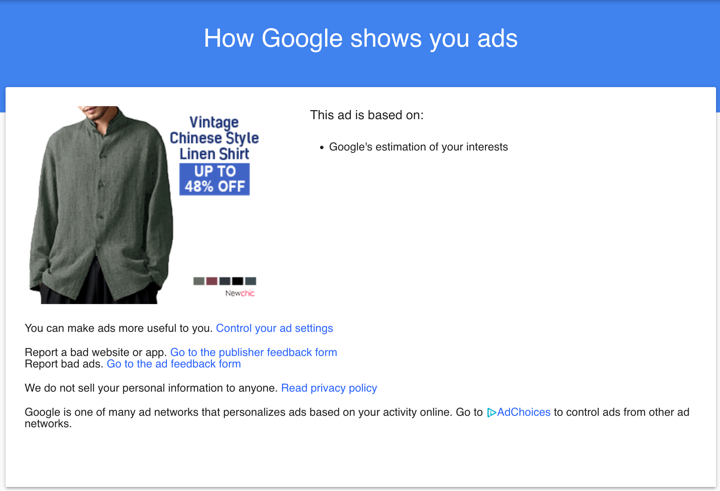
Explanation behind targeted ad

Slide 60
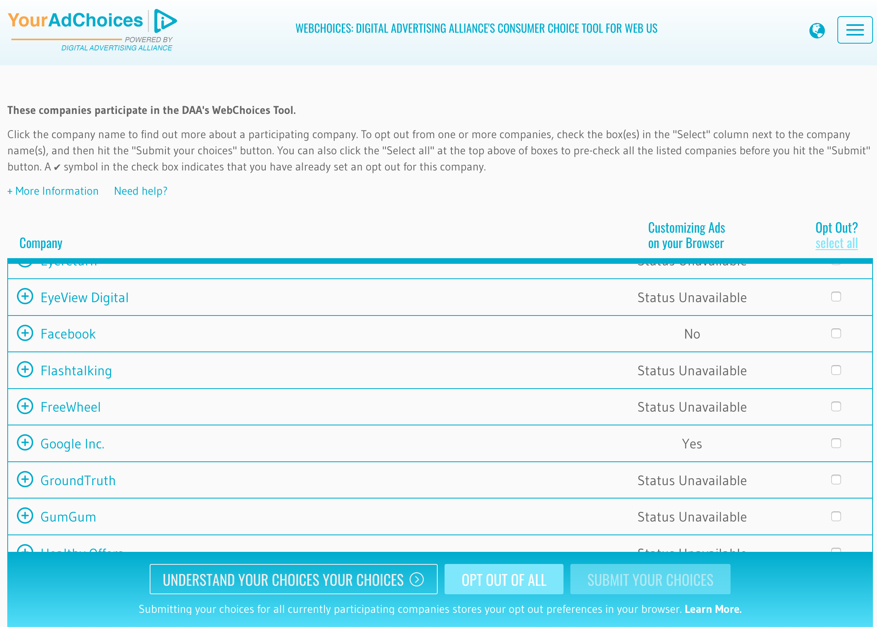
DAA opt-out choice

Slide 61

Cookie consent
Provides cookie banners
Sometimes no meaningful options exist
Sometimes cookies are stored even before agreeing

Slide 62
What did we learn
No sliver bullet solution to stop tracking
a combination of different techniques makes it harder for trackers
There exists a cat and mouse game between trackers and blockers
trackers tend to deny access to page if certain elements are blocked
need change to the eco-system
Users don’t negatively react to exposure and transparency tools
tracking companies should be more transparent and not fear resentment from users

Slide 63
Logistics
Homework 2 Due Sept. 21 by11:59pm
Project proposal review sent out
Start collecting/analyzing data or designing your system
Progress report due in about 3 weeks (need to showcase progress)
Office hours:
Anyone can attend any of the two sessions
Tu 8-9pm or Th 2-3pm

